Slide 1
Open Architecture Curriculum in Government Foreign Language Training Programs
Chair: Evgeny Dengub
Panelists: Betty Lou Leaver
Andrew Corin
Irene Krasner
Discussant: Jane Shuffelton
AATSEEL 2020
Friday, February 7, 2020

Slide 2
The Origins & Theoretical Bases of Open Architecture Curricular Design (OACD)
A Step on the Road to
Transformative Learning
A Presentation for AATSEEL 2020
Betty Lou Leaver, PhD

Slide 3
Toward a definition
Open Architecture Curricular Design (a term taken from a parallel concept in computer design that allows for interchangeable parts) supports increasingly textbook-free classrooms as learners develop greater proficiency and teachers modify syllabi corresponding to learners’ changing needs [Leaver, Davidson, & Campbell, in press]
Term introduced at the Defense Language Institute Foreign Language Center in 2015 by Leaver as part of an institute-wide initiative to raise proficiency of basic course graduates (Leaver, 2016; Dababneh, 2018; Krasner, 2018; Campbell, in press)

Slide 4

The emerging concept
TBI
tasks
LCI
contracts
TLLT
TLLT
CBI
modules
CLT
authentic materials
DA
formative tests
OACD
PBI
projects
SBI
scenarios
satellite/distance ed
individualized lessons
mastery learning
self-paced lessons

Slide 5
Intersecting & parallel practices
supplemental
materials
textbook
adult education
(Knowles, Maslow)
formative assessment/ZPD
attenton to diversity & learner differences
teaching to near-native
Until about 2010, OA lessons were in supplementation of a textbook with notable exceptions — at DLIFLC* in the 1990s, the Foreign Service Institute* in the 1980s, and a few K-16 programs.
*Influence of confluence in USG programs of rapid acquisition requirements & faculty accountability.

Slide 6
Shifting paradigms
 | Transmission | Transaction | Transformation
Theory | Mastery Learning (Bloom) | Experiential Learning (Dewey, Freire) | Humanistic Learning (Rogers, Maslow)
Classwork | Exercises Memorization | Tasks | Self-directed study Individualized learning
Homework | Written work | Projects | Research
Teacher | Knower | Facilitator | Advisor
Tests | Achievement | Proficiency | Formative/ Diagnostic
Syllabus | Form-based Theme-based | Task-based Content-based | Contracts Open architecture
adapted from Miller & Seller, 1985 and Leaver & Granoien, 2000

Slide 7
References
Campbell, C. (In press.) Open architecture curricular design (OACD). In B. L. Leaver, D. E. Davidson, & C. Campbell. Transformative language learning and teaching. Cambridge, UK: Cambridge University Press.
Clifford, R. (1988). Foreign languages and distance education: Next best thing to being there. Monthly Catalog of U.S. Government Publications: 93-4454. Washington, D.C.: U.S. Government Printing Office.
Corin, A. (In press.) In B. L. Leaver, D. E. Davidson, & C. Campbell. Transformative language learning and teaching. Cambridge, UK: Cambridge University Press.
Corin, A. (1997). A course to convert Czech proficiency to proficiency in Croatian and Serbian. In S. B. Stryker & B. L. Leaver, Content-based instruction in foreign language education: Models and methods (pp. 78-104). Washington, DC: Georgetown University Press.
Dababneh, R. (2018). The scenario-based syllabus for the post-basic Arabic program. Dialog on Language Instruction, 28(1), pp. 13-26.
Krasner, I. (2018). Open architecture approach to teaching Russian as a foreign language. Newsletter of the American Council of Teachers of Russian, 45 (2), 1-5.

Slide 8
References, cont’d
Leaver, B. L., & Campbell, C. (2020). The shifting paradigm in Russian language programs from communicative language teaching to transformative language learning and teaching. In E. Dengub, I. Dubinina, and J. Merrill (Eds.), Art of Teaching Russian. Washington, D.C.: Georgetown University Press.
Leaver, B. L., Davidson, D. E., & Campbell, C. (In press.) Introduction. In B. L. Leaver, D. E. Davidson, & C. Campbell, Eds., Transformative Language Learning and Teaching. Cambridge, UK: Cambridge University Press.
Leaver, B. L., & Granoein, N. (2000). Философия образования: Почему мы преподаем определенными путями. Философия Образования 1(1), 3-9.
Leaver, B. L., & Willis, J. (2005). Task-based instruction in foreign language education: Practices and programs. Washington, DC: Georgetown University Press.
Miller, J. P., & Seller, W. (1985). Curriculum: Perspectives and practice. Boston, MA: Addison-Wesley.
Roby. E. L. (2020). Transformative education: Teaching empathy through real work with real people; Part I. ACTR Letter 46(1): 1-2, 4-5, 7.

Slide 9
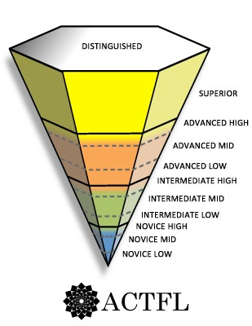
The Challenge of the Inverted Pyramid
Open Architecture and Learning Efficiency in Achieving Superior and Distinguished Levels of Proficiency
Andrew R. Corin
Professor Emeritus, DLIFLC
arcrmc@att.net
Notes:
Introduction: My initial intent had been to provide what would essentially be the oral version of a book chapter that will appear late this year (Corin, in press). In that article I describe an OA curricular model, or “template,” designed and implemented across multiple languages at Defense Language Institute Foreign Language Center (DLIFLC) for multiple purposes between 2012-2014, together with a confluence of external forces that gave urgency to this effort. I had intended to follow generally the structure of that paper, but with additional emphasis on the relationship between OACD and the so-called inverted pyramid. I selected this emphasis because it appeared that one of the reasons (not the only reason, but a significant one) why this OACD model had proven effective (in those contexts in which it had been employed, to be sure) is that it was countering the “inverted pyramid effect” in a very specific way. My intent was thus to explore one reason why we expect modular OACD to generally yield more rapid proficiency gain than “traditional” textbook courses that are organized according to linear scope and sequence.
As I began to prepare, I found myself concentrating more and more on attempting to understand the inverted pyramid construct itself, including its history, structure, motivation and validation, since the identification of strategies to counter it (including that explored in this presentation) inevitably depends on a clear understanding of that construct.
Today, then, I plan to first examine one way in which modular OACD functions to counter the inverted pyramid through a strategy that I term “vertical spiraling.” I will then provide two illustrations of different forms of OACD from DLI practice that have delivered unexpectedly rapid proficiency gains, in part through their adoption of vertical spiraling. Finally, depending on the time available, I will return to discuss the inverted pyramid from a theoretical perspective. The goal of this final section will be to question the nature and scope of validity of the inverted pyramid construct in every possible respect, with a view to defining the most realistic perspective within which to address possibilities and opportunities to avoid or counter it.
Before we begin, let’s examine this very familiar figure of the “ACTFL Inverted Pyramid,” noting several of its features. Note:
The levels and sub-levels themselves
Their relationship to the levels of the ILR scale
The striking depiction of the Distinguished level as a ceiling rather than a volume.
The six (un-labled!) sides of the pyramidal structure. Why six, and what do they signify?
The slope of the pyramid’s sides, their regularity (symmetry) and linearity as opposed to a slope with some positive or negative acceleration.
These are all potentially weighty matters with significance for: 1) instruction/curriculum, 2) counseling, 3) and strategic decision-making, including program planning and resource allocation.*
I would suggest that despite its ubiquity in graphic representations of language proficiency, and broad acceptance by many today, practitioners and theoreticians alike, this construct and its implications have to date been the object of relatively little research. Overall, there appears to be but a sparse literature on the history of the inverted pyramid concept, the nature of its construct, and validation.
To the extent that time allows, I will go back and examine each of these matters (formulated as questions on the following slide) and address briefly how they affect our striving to enable learners to achieve ILR 3 and higher (Superior and Distinguished) L2 proficiency.
*For just one opinion on this issue from a USG perspective, see how this was phrased by Vincent (1978, 231): “How much consensus would there be to a more complicated set of questions? Which is more difficult to achieve, and how much more: reaching a 3 level from a 0+, or a 4 from a 3+? How long should the average student in each category be enrolled in training? Is it possible to project from known durations of training to situations where, as yet, no data exist?
These and similar kinds of questions have cropped up time and again during a series of joint research efforts by the Psychological Services Staff (PSS) and the Language School (LS) to predict the speaking efficiency of language students at the conclusion of training.”
Literature:
Corin, A. (in press). Foreign Language Learning Efficiency: Transformative Learning in an Outcomes-Based Environment. In Betty Lou Leaver, Dan Davidson and Christine Campbell, ed., Transformative Language Learning and Teaching. Submitted to Cambridge University Press.
Vincent, Robert J. "Psychophysical Scaling of the Language Proficiency Interview: A Preliminary Report," pp. 229-53, in John L. D. Clark, ed., Direct Testing of Speaking Proficiency: Theory and Application. Proceedings of a Two-Day Conference conducted by Educational Testing Service in cooperation with the U.S. Interagency Language Roundtable and the Georgetown University Round Table on Languages and Linguistics, March 1978.

Slide 10
The Inverted Pyramid:
Key Questions
Origin & History of the Inverted Pyramid Concept
What is the Inverted Pyramid “of”?
  Quantity of content/learning?
  Time to next proficiency level?
What is the Inverted Pyramid’s Shape?
  How many sides does/should it have?
  Is its shape regular?
  What is its slope: arithmetic, exponential, how large…?
  Does it look the same for all learners?
Does the Inverted Pyramid Even Exist? (Validation)
What causes the Inverted Pyramid?
What can we do about it?
ATSEEL 2020: Corin
Notes:
To the extent that time allows, I will go back and examine each of these matters and address briefly how they affect our striving to enable learners to achieve ILR 3 and higher (Superior and Distinguished) L2 proficiency.

Slide 11
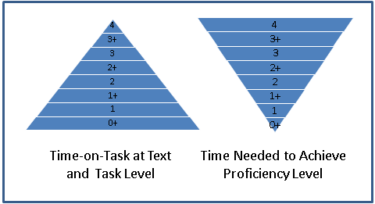
Time-on-Task at Text/Task Level:
Linear Scope and Sequence
ATSEEL 2020: Corin
Notes:
Before we do that, I want to first present this slide that encapsulates a large part of my argument.
Let us consider the two pyramids in this figure, only one of which is inverted. They are both simplifications, but should serve to make an important point.
Linear scope and sequence refers to the sequenced introduction of specific linguistic and paralinguistic elements, task and text types. It is, more or less, what a traditional textbook does, especially at lower levels of study.
The inherent problem with this approach is that it limits, progressively, the time on task that learners have with progressively higher-level text and task types, as well as with specific linguistic and paralinguistic elements associated primarily with them. The higher the level of text/task types (including the linguistic/paralinguistic elements typically associated with them), the less time-on-task learners will have with them. Linear scope and sequence, in this way, would naturally tend to reinforce, if not in part actually to cause, an inverted pyramid of proficiency growth.
Modular open architecture curriculum eliminates most elements of sequencing (albeit not all; see Dababneh, 2018 and Corin, in press), and in so doing mitigates the problematic non-inverted pyramid of time-on-task with ever higher-level text and task types and associated linguistic/paralinguistic elements.
So, aside from other more obvious benefits of open architecture (including, inter alia, easier/more rapid development, deployment and modification to meet learner need), it should also, in principle, promote accelerated attainment of proficiency, especially at the upper ranges. We will provide two illustrations of success in doing just that by means of such curriculum. These are successes that were achieved, moreover, in otherwise adverse instructional circumstances.
Literature:
Corin, A. (in press). Foreign Language Learning Efficiency: Transformative Learning in an Outcomes-Based Environment. In Betty Lou Leaver, Dan Davidson and Christine Campbell, ed., Transformative Language Learning and Teaching. Submitted to Cambridge University Press.
Dababneh, R. (2018). The scenario-based syllabus for the post-basic Arabic program. Dialog on Language Instruction, 28(1), pp. 13-26.

Slide 12
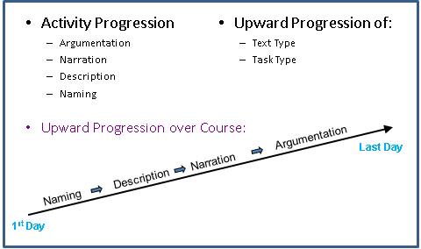
Time-on-Task at Text/Task Level:
Linear Scope and Sequence
ATSEEL 2020: Corin
Notes:
So, how does this work out? Let’s first examine an (over-simplified, to be sure) schematic of how the non-inverted pyramid works in practice…
Let’s bear in mind that this progression refers not just to task types, but also to the text types associated with them, as well as to the sequenced introduction of vocabulary, phraseology, syntax, discourse structure, socio-cultural elements, etc., associated with ever higher-level text and task types.
Now, let’s say that instead of carrying out your progression between the first and last day of the course, you shorten it to progressing from lowest to highest level between the first and last day of the month, after which you begin the same progression all over again. Or, instead of abbreviating the progression to monthly cycles, you reduce it to weekly, daily, or even hourly cycles.

Slide 13
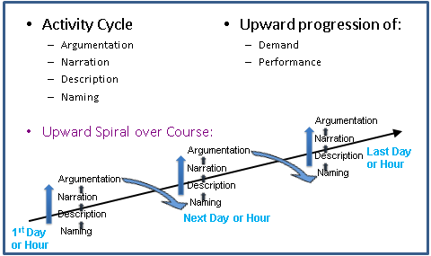
Time-on-Task at Text/Task Level:
Vertical Spiraling
ATSEEL 2020: Corin
Notes:
This yields a cyclic progression as portrayed in this slide.
I refer to this as vertical spiraling. It consists of a cyclic repetition of series of tasks/activities of ever-increasing complexity based on authentic materials. In each iteration learners achieve greater skill in performing tasks and working with texts at each level, either within or across differing content areas.
Compare this to the “traditional” concept of spiraling as a principle of curricular organization, which is based on a periodic recycling of content areas. During each iteration, learners achieve greater breadth and depth of understanding. Here, instead of cycling through content areas, we are cycling through levels of task complexity.
Within a vertical spiraling approach, learners’ exposure to, and time-on-task with, higher-level text and task types and associated linguistic and paralinguistic elements naturally approaches their exposure to, and time-on-task working with, lower-level text and task types.
To be sure, during early iterations, learners’ performance with higher-level text and task types is limited, even rudimentary. The approach seeks to incrementally increase levels of performance at each task level and with texts of each level.

Slide 14
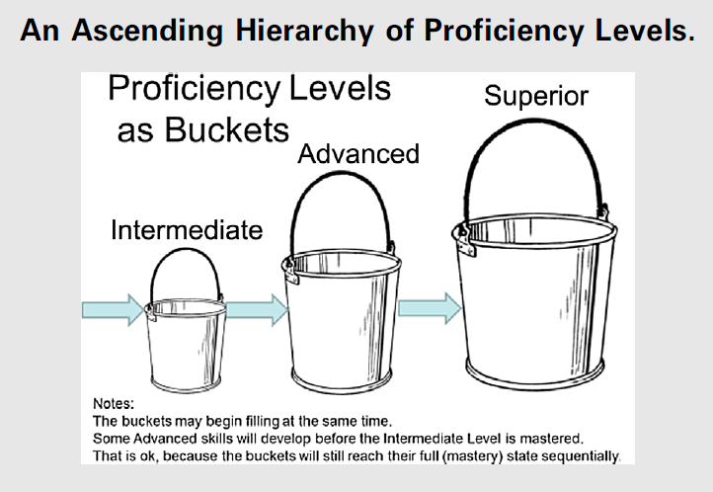
R. Clifford (FL Annals, 2016):
Fig. 1, p. 230
ATSEEL 2020: Corin
Notes:
Vertical spiraling thus promotes, and explicitly “programs” into the curriculum, a phenomenon (illustrated by Clifford’s [2016, 230] bucket analogy) that occurs during L2 learning presumably regardless of instructional/curricular approach, only less systematically.
Literature:
Clifford, Ray. (2016). A Rationale for Criterion-Referenced Proficiency Testing. Foreign Language Annals, Vol. 49, Iss. 2, pp. 224–234. DOI: 10.1111/flan.12201

Slide 15
Elaine Tarone:
Don’t be so worried about what your students “can’t” do. (They very likely can, just not as well at first.) Don’t place a glass ceiling over them by limiting the tasks that you allow them to attempt.*
*Paraphrase from a Pre-Conference Workshop, Tenth International Conference on Language Teacher Education, University of California, Los Angeles, 2 February 2017
ATSEEL 2020: Corin
Notes:
Vertical spiraling also operationalizes the admonition of Tarone (2017), presented in this slide.
After all, how much proficiency is really required for learners to begin to express and support opinion? Proficiency in this activity is characteristic of ILR Level 3 (Superior). Yet, all one really needs to express opinion in a rudimentary way is a phrase corresponding to “I believe/think” and the ability to express a simple proposition, which need not be grammatically correct and need not even be comprehensible to non-natives. To support opinion one requires no more than “because” and the ability to express, in however rudimentary a form, a simple proposition. Learners can thus begin to express and support opinion at ILR 0+ (Novice High) at the latest. Performance will be rudimentary, but it will be enhanced incrementally over innumerable iterative rehearsals long before learners reach a sustainable ILR Level 2 (Advanced). That is what vertical spiraling promotes. [A counter-argument might be that this may promote fossilization of learned error, but this need not occur. Explanation requires more discussion than can be provided with this slide, but it involves, at least in part, cognitive and learning style. In short, some students tend fossilize no matter what approach is employed, while others resist fossilization regardless of approach. There is as yet no research base on which to base conclusions in regard to fossilization in a vertical spiraling environment, and there are gaps between the populations with which we have utilized this modular OACD approach, which makes even prima facie comparisons difficult. In our experience, there is at least no empirical basis for believing that this is an actual problem.]
Now we will move on to two illustrations of open architecture curricula based on vertical spiraling, both from USG (DLIFLC) programs
First we will take a fairly straightforward example of a scenario-based instructional approach carried out during a conversion program, in which vertical spiraling stands out most clearly: Czech > SC conversion (1993).
Then we will move on to a more complex SBI-CBI example: DLIFLC post-DLPT (initiated 2012-2013) and shortened intermediate/advanced courses (initiated 2013-2014).
Literature:
Tarone, E. (2017). “Exploring Learner Language in Language Teacher Education,” pre-conference workshop at the Tenth International Conference on Language Teacher Education, University of California, Los Angeles, February 2, 2017.

Slide 16
DLIFLC 1993: Czech → S/C Immersion Conversion Course
Two Weeks Heads Up to DLIFLC
No Program, Instructors, Texts, Grammars, Dictionaries
Course Length: 12 Weeks
Objectives: 1+ Listening, 1+ Reading, 1 Speaking
Resources:
  Instructors, personal materials + periodicals + SCOLA
  Students’ schemata from Czech
  Students’ content- and scenario-related knowledge
  Immersion Conversion Method
ATSEEL 2020: Corin

Slide 17
DLIFLC 1993: Czech → S/C Immersion Conversion Method
Target Language Only from Day 1
Curriculum: Modular Open Architecture
Task-Based Instruction
  Content-Based Instruction
  Project-Based Instruction
    Student Driven
  Scenario-Based Instruction
    Student Driven
    Vertically Spiraled
ATSEEL 2020: Corin

Slide 18
Vertical Spiraling in SBI
CZ → SC Conversion Course
Vehicle Search:
Military schemata: Protocols for vehicle searches
Linguistic schemata: verbs, parts of car, phraseology
Cultural schemata: defusing rather than inflaming situations
Props: vehicles, weapons, mirrors, various forms of contraband
Situation cards: drivers, soldiers (materials considered contraband, rules for allowing passage, sending people back or detaining them; situation on the ground; rules of engagement)
Practice in classroom
Try out in improvised field environment (street, parking lot)
Debrief and troubleshoot in classroom
Return to field and practice until proficient
ATSEEL 2020: Corin
Notes:
The following example was applied during a Czech – Serbian/Croatian immersion conversion course (1993). To the best of my knowledge, this was the first application of what has become a “classic” SBI scenario for military language students.
It was one of a number of scenarios that were employed during this course. Some of these represented a fairly straightforward SBI approach, in which the elements of vertical spiraling stand out clearly. In a number of other instances a combined SBI-CBI approach was applied.
NB: This slide is borrowed from Corin (2008a).
Literature:
Corin, A. (1997). A course to convert Czech proficiency to proficiency in Croatian and Serbian. In S. B. Stryker and B. L. Leaver (Eds.), Content-Based Instruction in Foreign Language Education: Models and Methods (pp. 78-104). Washington, D.C.: Georgetown
Corin, A. (2008a). “Mission Impossible: 40 Novice Students, No Materials, Untrained Instructors, 10 Weeks until DLPT (Serbian – Croatian 1993),” Defense Language Institute, School of European and Latin American Studies, 3 June 2008.
Corin, A. (2008b). “Lessons of the 1993 Serbian – Croatian Conversion Course (Mission Impossible Continued)” Defense Language Institute, School of European and Latin American Studies, 26 June 2008.
***********************************
Some comments from the “Mission Impossible” presentation (from which this slide is adapted):
In a context in which “a lot of bang for the buck” wasn’t good enough, and only “maximum bang for the buck” was acceptable, this was how to achieve it:
Maximum engagement of student initiative (toward motivation)
Maximum exploitation of task-based approach
Maximum integration of skills
Maximum engagement of student involvement (adds kinesthetic aspect of learning)
Maximum integration of aspects of language in a single learning exercise
Maximum approach to real-world scenario
Maximum approach to real-world scenarios of relevance to our students.
Maximum integration of attention to language with competing demands upon attention as in real-world situations.
Generally:
A. Maximizes the number and type of associations created or reinforced during the learning process
B. Maximizes the approach to real-world training.
C. Maximizes the approach to the normal form of military training: learning, and then practicing until perfect in the most realistic possible environment.
Under this method, and with the severe time constraints and unforgiving context (because of the time constraint, that is, not because we lacked compassion), the “analytic” [i.e., generally, more “ectenic” learners, in terms of the E&L Cognitive Style Construct] learners found it difficult to cope. [The presentation goes on to describe adaptations made to mitigate this undesired effect of the initial course design.]

Slide 19
Vertical Spiraling in SBI Conversion Course: Results
DLPT 4
11th Week
Testing
Objectives:
  Reading: 1+
  Listening: 1+
  Speaking: 1
 | Oral | Reading | Listening
3 | 2
2+ | 1 | 1 | 1
2 | 11 | 5 | 1
1+ | 17 | 18 | 10
1 | 9 | 16 | 21
0+ |  |  | 7
ATSEEL 2020: Corin
Notes:
A number of factors affected these striking results. Vertical spiraling was certainly prominent among them. This is indicated in part by the relationship of the oral proficiency outcomes to those for listening and reading.
From notification of the requirement to prepare for this course until the arrival of the students, DLIFLC had around two weeks in order to hire and organize an instructional team, and to prepare curriculum and a course plan. DLIFLC’s Serbian/Croatian Basic Course program had been eliminated several years earlier, so neither instructional staff nor instructional materials were readily available. The course was conducted without textbooks, with dictionaries from the mid-point of the course, and with just such materials as the instructors could collect from their personal collections, along with available newspapers and magazines, and SCOLA. In this context, executing the course effectively was exhausting in the extreme. The out-going DLPT/OPI results suggested that it would be beneficial to explore how to make such an approach sustainable (indicate the challenges).
The 40 students in this course were conversion students. Each had previously completed the DLIFLC Basic Course program in Czech. Though we did not have access to their incoming CZ DLPT/OPI scores, we estimated that their CZ proficiency was generally in the range between ILR 1+ and 2+, with ILR 2 as perhaps the most commonly occurring level. The results strongly suggested that it would be beneficial to explore how to make such an approach amenable to application with true novices.
Note that OPI outcomes were strikingly higher than were DLPT outcomes for reading and listening. This contrasts to the otherwise almost universal pattern, in which reading and listening proficiency outcomes exceed those for speaking proficiency.

Slide 20
DLIFLC 2012 – 2014:
Modular OA Template: Context
2012-: Post-DLPT Courses (entry c. ILR 1+)
2013-: Shortened Intermediate/Advanced Courses (≥ 2)
2015-: Expansion into Basic Course Semester 3
Existing Community of Practice:
  Modular Open Architecture Curriculum (no textbook or S&S)
  Diagnostic Instruction and Assessment
  TL Only Instruction; Authentic Texts Only
  SBI and CBI
Strategy: Concentrate Best Practices for Enhanced Effect
  Fully Integrated Curriculum
Imperative: Rapid Development & Adaptation
  Modular OA Fully Integrated Curriculum
ATSEEL 2020: Corin
Notes:
2012: I was tasked by the Provost to find a way to improve the performance of our post-DLPT courses.
2013: As Dean of the School of Resident Education in CE, I was faced with the impending replacement of our resident intermediate and advanced courses (6-12 months) with courses roughly 3-4 months in length but with essentially identical proficiency objectives (+ .5 level increase).

Slide 21
DLIFLC 2012 – 2014:
Modular OA Template
Week-Long SBI-CBI Modules
Culminating Scenario
Fully Integrated Activities
  Every activity reinforces every other activity
  Every activity builds toward the culminating activity
  Every student depends on inputs of every other student
  Moderate topical scope to enable integration
  Initial negotiation of sub-topics, concentration: promote student autonomy, mental mapping
Daily Sub-Topics Maximize Reinforcement
  Students gradually build performance skills for culminating scenario
ATSEEL 2020: Corin
Notes:
Based on Corin (in press).
Literature
Corin, A. (in press). Foreign Language Learning Efficiency: Transformative Learning in an Outcomes-Based Environment. In Betty Lou Leaver, Dan Davidson and Christine Campbell, ed., Transformative Language Learning and Teaching. Submitted to Cambridge University Press.

Slide 22
Sample One-Week Module:
Humanitarian Aid to North Korea
Roles: Working group of a US-SK Joint Committee on NK
Culminating Activity (CA): Prepare recommendations to the Board of Directors (BoD), who will meet soon with visiting American policy-makers: what position should the Committee advocate in regard to humanitarian aid to NK?
Culminating Activity structure:
Stage 1. Debate pros/cons of alternative policies.
Stage 2. (i) Negotiate a consensus based on debate outcome; and, (ii) provide a brief to the BoD outlining pros and cons of alternative policies and their recommendation.
Wrap-up: Write a column on US humanitarian aid policy toward NK. Elaborate alternatives and support your opinion.
ATSEEL 2020: Corin
Notes:
From Campbell et al. (2017).
Module authored by Dr. Mina Lee, Defense Language Institute.
NB: All roles and content in this module are fictional. They do not, and are not intended to, bear any resemblance to any actual role or event.
This is a more complex, less schematic model of SBI-CBI (scenario-based content-based) modular open architecture.
It has been utilized on multiple occasions for professional development purposes at DLPT, with a reduced version employed in the Korean Basic Course program. Numerous modules of similar design have been employed across a range of languages (including Russian and Serbian-Croatian; see, for some further examples from a variety of languages, Dababneh, 2018 and Corin, in press) in the following contexts:
Post-DLPT cohorts (entry level c. ILR 1+)
Shortened intermediate/advanced courses (entry level c. ILR 2 and higher)
To an increasing extent, in advanced stages (typically Semester 3) of Basic Course programs (ILR level c. 1+)
It is designed to maximize integration of activities, such that:
(1) every activity/task builds both the knowledge base and performance skills required for the culminating scenario;
(2) every activity/task reinforces or depends on every other activity in that process of preparation;
(3) every learner depends crucially on inputs from every other learner at each stage of a module, creating a maximally cooperative learning environment, including during the multiple-stage culminating scenario (i.e., learners are integrated with one another); and
(4) every learner is enabled to mentally integrate their own learning, mentally map it out in advance and monitor it, essentially, to maximally take charge of their learning, through an initial negotiation of the process of preparing for the scenario.
The iterative process of task preparation and performance over a series of daily sub-topics (see the following slide), always building knowledge and skills with a view to the module’s culminating scenario, effectively creates a complex vertical spiral.
For further details and background see Corin (in press).
Literature
Campbell, C., Corin, A., Kanbar, H. & Leaver, B. L. (2017). “Pushing the Envelope: Transformative Pedagogy in Outcomes-Based FL Instruction,” Tenth International Conference on Language Teacher Education, University of California, Los Angeles.
Corin, A. (in press). Foreign Language Learning Efficiency: Transformative Learning in an Outcomes-Based Environment. In Betty Lou Leaver, Dan Davidson and Christine Campbell, ed., Transformative Language Learning and Teaching. Submitted to Cambridge University Press.
Dababneh, R. (2018). The scenario-based syllabus for the post-basic Arabic program. Dialog on Language Instruction, 28(1), pp. 13-26.

Slide 23
Sample One-Week Module:
Humanitarian Aid to North Korea
Daily Topics Working Up to the CA
Day 1. Scenario Set-Up; NK Humanitarian Situation
Day 2. SK political/humanitarian policies toward NK
Day 3. Six-party Talks; International Humanitarian Policies
toward NK
Day 4. Issues/Recent Developments in N/S Korea
Day 5. Last Updates/Information Exchanges; Culminating Activity
Each Day May Have Its Own Culminating Production Activity
ATSEEL 2020: Corin
Notes:
From Campbell et al. (2017).
The initial negotiation may suggest daily sub-topics along the lines of the following. Each can then be addressed over a series of activities, gradually building knowledge and performance skills related to critical discussion of each successive sub-topic.
For further details see Corin (in press).
Literature:
Campbell, C., Corin, A., Kanbar, H. & Leaver, B. L. (2017). “Pushing the Envelope: Transformative Pedagogy in Outcomes-Based FL Instruction,” Tenth International Conference on Language Teacher Education, University of California, Los Angeles.
Corin, A. (in press). Foreign Language Learning Efficiency: Transformative Learning in an Outcomes-Based Environment. In Betty Lou Leaver, Dan Davidson and Christine Campbell, ed., Transformative Language Learning and Teaching. Submitted to Cambridge University Press.

Slide 24
Persian Farsi Post-DLPT Results:
Modular OACD SBI-CBI
Course length maximum 8 weeks
22 Students with
known DLPT
results
Measured:
  Reading
  Listening
Students | Increase
19 | .5 level R and/or L
9 | 1.0 level R and/or L
4 | 1.5 levels R or L
1 | 2.0 levels (1-3 L)
ATSEEL 2020: Corin
Notes:
These results serve as an example of what may be achieved. They represent outcomes of Persian Farsi Post-DLPT cohorts held over an approximately one year period between 2011 and 2012 (for an explanation of the dates, see Corin, in press). It should be borne in mind that the students in question had just failed to achieve graduation requirements (ILR Level 2/2/1+ for listening/reading/speaking) over the course of a year-long program. That they were able to achieve the results indicated in this slide in no more than eight additional weeks is striking.
On the relative paucity of tracking and statistical analysis of outcomes, cite anecdotal notes regarding the difficulty of research in the USG L2 training environment, including systematic tracking the results of curricular experiments over time due to the operational tempo, ever-shifting programmatic needs and vetting requirements.
“Lowe’s lament” (my characterization, ARC) of 1985 (1985b, 33), which is still largely true today and remains an enduring complaint of untold USG linguists: “Unlike the camp at the foot of the mountain that is overflowing with data and theory, research life at the base camp contains less theory than data. The data are more experiential than empirical. Government linguists rarely have the leisure to gather empirical facts, organize them, interpret them, write them up. It is a frustration balanced by the variety of levels encountered with the wealth of data to be researched.”
The note regarding the non-publication of earlier research results from another USG setting (Foreign Service Institute) in Leaver and Corin (in press, Fn 5).
Literature:
Corin, A. (in press). Foreign Language Learning Efficiency: Transformative Learning in an Outcomes-Based Environment. In Betty Lou Leaver, Dan Davidson and Christine Campbell, ed., Transformative Language Learning and Teaching. Submitted to Cambridge University Press.
Leaver, Betty Lou & Corin, Andrew R. (in press). Fields of the Mind: An Integral Learning Styles Component of the E&L Cognitive Styles Construct. Russian Language Journal.
Lowe, Pardee, Jr. (1985b). “The ILR Proficiency Scale as a Synthesizing Research Principle: The View from the Mountain.” In James, Charles J., Ed. (1985). Foreign Language Proficiency in the Classroom and Beyond. Lincolnwood, Illinois: National Textbook Company (in conjunction with the American Council on the Teaching of Foreign Languages), pp. 9-54.

Slide 25
The Inverted Pyramid:
Key Questions
Origin & History of the Inverted Pyramid Concept
What is the Inverted Pyramid “of”?
  Quantity of content/learning?
  Time to next proficiency level?
What is the Inverted Pyramid’s Shape?
  How many sides does/should it have?
  Is its shape regular?
  What is its slope: arithmetic, exponential, …?
Does the Inverted Pyramid Even Exist? (Validation)
What causes the Inverted Pyramid?
What can we do about it?
ATSEEL 2020: Corin
Notes:
Now, let’s go back and examine each of the questions that we identified at the outset concerning the theoretical construct of the inverted pyramid, and show how their answers affect our efforts to enable learners to achieve superior and distinguished L2 proficiency.
After all, the claims and exemplification provided above depend in part on the inverted pyramid for their justification and explanation. If the construct itself is invalid, is incorrectly conceived or construed, or contains further complexities not part of our usual conception of it, then these explanations and proposals for appropriate treatment may be affected or brought into question.

Slide 26
Origins of the Inverted Pyramid
Applied psychophysical research to relate:
  Relationship: real vs. perceived strength of physical stimuli
  Judgments of: difficulty to achieve proficiency levels
  Actual training time to achieve proficiency levels
All are described by the formula: ψ = k(φ – φ₀)^{n}
Vincent 1978
Cited by Lowe 1985b
ATSEEL 2020: Corin
Notes:
Vincent’s hypothesis, which he conceived of as an initial attempt to scale the difficulty of learning foreign languages, arose out of research into the relationship between the real vs. perceived strength of sensory stimuli (e.g., “loudness, brightness, taste, heaviness, judged intensity of electric shock” [Vincent 1978, 232]).
“…the perceived magnitude ψ grows as the physical scale φ raised to a power n.The φ₀ is often thought of as a threshold, while k is merely a constant that depends upon the units employed. One particularly useful feature of this law is that when log ψ is plotted against log φ, the resulting power function is a straight line. Most importantly, each of the modalities abiding by the law seems to have a characteristic exponent (n), ranging from 0.3 for brightness to 3.5 for apparent intensity of electric shock (Stevens, 1961).” (Vincent 1978, 232)
Note that the slope is described by the formula as “exponential,” rather than “arithmetic.”
Note also that in this formula the exponent is a variable. It is worth noting that it can be greater than 1.0, but can also be less than 1.0.
Vincent goes on to explain that this research was expanded in the 1950s to include “stimuli that could be described only on a nominal (nonmetric) scale—attitudes, verbal statements, occupations, crimes, punishment, and musical selections, to name just a few (Stevens, 1966).” (Vincent 1978, 232). Where metrics could be scaled, the psychophysical power law seemed to hold.
“Given this background, it seemed worthwhile to bring the psychophysical tools to bear on the matter of scaling the difficulty of learning a foreign language.” (Vincent 1978, 232).
Vincent proceeded to study Language School (LS) instructors’ judgments (sic!) as to the difficulty of attaining any particular level of proficiency based on the FSI (now ILR) scale. The results, based on two differing techniques, yielded a flaring (“exponential” in later parlance) result when one directly graphed perceived difficulty against proficiency levels expressed as an ordinal scale (0 – 5). Interestingly, his results did indeed conform to the psychophysical power law (though I was not able to fully follow the statistical process through which they were derived, as Vincent described them only by reference to other sources--Stevens 1960, Ekman 1961, Mashhour 1961, and Forgerson 1958—whom the researchers followed), “Where ψ refers to estimated difficulty, k is a constant with a value of .01 or .03, depending on the psychophysical technique, φ is duration of training, φ₀ is a constant with a value of 37 for magnitude estimation and 0 for ratio estimation, and n = 1.00 for magnitude estimation and 1.03 for ratio estimation.” (Vincent 1978, 235) This function graphs to a straight or nearly straight line, where the X axis is expressed in what appears to be a logarithmic progression. The two equations are:
Magnitude estimation: .03 (Hours in training - 37 hours)^{1.00}
Ratio estimation: .01 (Hours in training)^{1.03}
Interestingly, these results for observers’ judgments of difficulty to achieve particular proficiency levels were directly proportional to database records of actual training time required to reach particular proficiency levels up through Level 3+ (which is not entirely surprising if one assumes that the actual basis of observers’ judgments of difficulty would typically have been their recollection of students’ actual training times required to reach particular proficiency levels, ARC).
LS databases on training times to particular proficiency levels contained data up to and including Level 3+. For this reason, “[t]he power functions were calculated exclusively on the basis of training duration data found in the 0 through 3+ FSI categories; training durations associated with the 4, 4+, and 5 levels were then projected on the basis of the resulting power functions (and shown as filled data points in Figure 1).”
Today it is unclear whether Clifford’s 1980 paper cited Vincent (1978) as a source, but Clifford appears to have been present at the conference at which Vincent presented his work. Lowe (1985b, 25) strongly suggests but does not explicitly claim this connection.
My sense is that Clifford probably saw that these results appeared to dovetail with long-standing observations by USG language professionals concerning the course of L2 proficiency development, and that they suggested a graphic representation which he proceeded to formulate the following year (1979 according to Clifford, personal communication).
Literature:
Lowe, Pardee, Jr. (1985b). “The ILR Proficiency Scale as a Synthesizing Research Principle: The View from the Mountain.” In James, Charles J., Ed. (1985). Foreign Language Proficiency in the Classroom and Beyond. Lincolnwood, Illinois: National Textbook Company (in conjunction with the American Council on the Teaching of Foreign Languages), pp. 9-54.
Vincent, Robert J. "Psychophysical Scaling of the Language Proficiency Interview: A Preliminary Report," pp. 229-53, in John L. D. Clark, ed., Direct Testing of Speaking Proficiency: Theory and Application. Proceedings of a Two-Day Conference conducted by Educational Testing Service in cooperation with the U.S. Interagency Language Roundtable and the Georgetown University Round Table on Languages and Linguistics, March 1978.

Slide 27
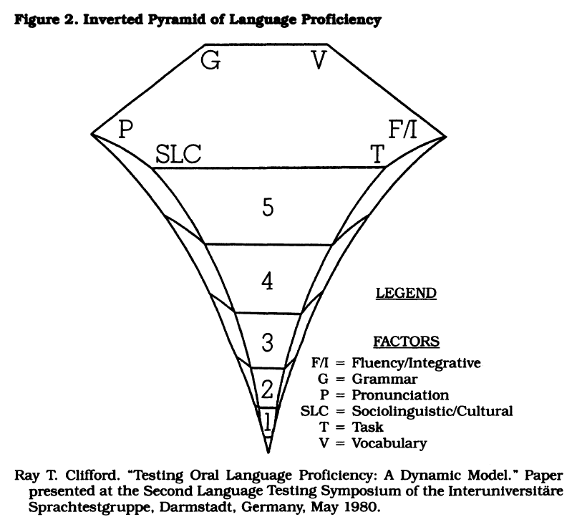
Origins of the Inverted Pyramid
Clifford 1979
Clifford 1980*
*cited from Lowe 1985a
ATSEEL 2020: Corin
Notes:
The concept of the inverted pyramid (as a visual presentation) originated with Ray Clifford in 1979 (Clifford, personal communication).
The inverted pyramid appears to have been first presented visually by Clifford in an unpublished conference paper in 1980 (apparently not available; I’ve asked).
(The original depiction may have differed in one respect from that presented in his 1980 paper.)
Clifford’s 1980 depiction was republished by Pardee Lowe, Jr., in two 1985 publications. (1985a and 1985b).
The facets of the pyramid corresponded to the performance domains relevant to measuring oral proficiency posited by Clifford and colleagues at that time.
What are explicitly depicted by the pyramid appear to be domains of performance, rather than times to proficiency level.
The slope is “exponential,” rather than linear (“arithmetic”).
We can’t see today whether Clifford, in his 1980 paper. cited Vincent (1978), but Clifford was apparently present at the conference at which Vincent presented his work.
Literature:
Clifford, Ray. (1980). “Testing Oral Language Proficiency: A Dynamic Model.” Unpublished paper presented at the Second Language Testing Symposium of the Interuniversitäre Sprachtestgruppe, Darmstadt, Germany, May 1980. (Cited from Lowe, 1985a, 1985b)
Lowe, Pardee, Jr. (1985a). “Proficiency-Based Curriculum Design: Principles Derived from Government Experience.” Die Unterrichtspraxis / Teaching German, Vol. 18, No. 2 (Autumn, 1985), pp. 233-245. https://www.jstor.org/stable/3530456.
Lowe, Pardee, Jr. (1985b). “The ILR Proficiency Scale as a Synthesizing Research Principle: The View from the Mountain.” In James, Charles J., Ed. (1985). Foreign Language Proficiency in the Classroom and Beyond. Lincolnwood, Illinois: National Textbook Company (in conjunction with the American Council on the Teaching of Foreign Languages), pp. 9-54.

Slide 28
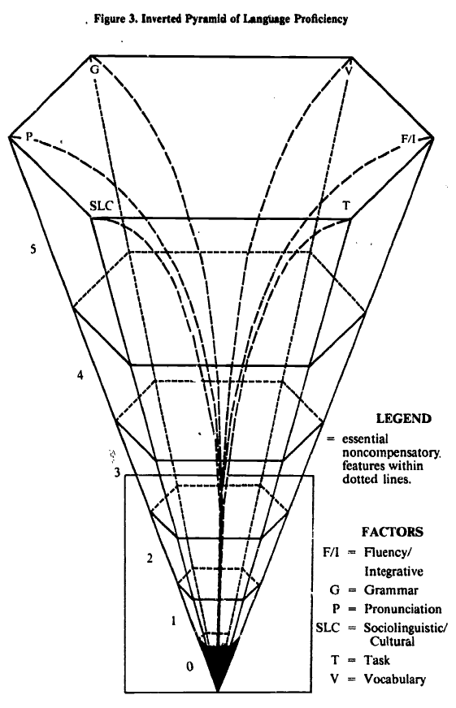
Origins of the Inverted Pyramid
Lowe 1985b
ATSEEL 2020: Corin
Notes:
Lowe’s 1985b depiction of the ILR Scale inverted pyramid shows development in two respects.
It encloses the flaring (“exponential”) slope of the pyramid in straight lines which connect Level 0 with the top of the Level 5 range. The reason for this is not discussed in this work or other studies with which I am familiar. We may speculate that this was done in order to produce a more easy-to-view or easy-to-examine representation, or it may have been done in view of researchers’ uncertainty as to the “actual” slope of the pyramid. This latter suggestion seems unlikely to be correct, however, as Lowe states in the same paper that (emphasis added; see Lowe 1985b, p. 25), “[a] complicating factor in discussing the scale is its exponential growth, which Vincent (57) established through a study in psychophysical scaling with Language School raters and which Clifford depicts graphically in his Inverted Pyramid (Figure 3).”
Lowe’s Figure 3 (1985b) enclosed the lower ranges of proficiency (Level 0 – 2+) in a box, apparently to indicate the partially compensatory nature of those lower levels, in distinction to the entirely noncompensatory nature of the upper levels of proficiency (ILR 3 and above). [The following quote is also included below in the “What Causes the Inverted Pyramid?” slide]. Lowe (1985b, pp. 20-25): “Earlier both Lowe (46) and Clifford (16) had questioned the traditional set of five Foreign Service Institute factors and the way in which they had been regarded as contributing to the global score. Lowe referred to them as the static model since the now abandoned weighting table statically applied the weightings of the Level 2+/3 border to all levels throughout the scale. Clifford proposed a dynamic model which would recognize the uniquely noncompensatory nature of the ILR scale's upper end (Level 3 and higher) and the gradually more compensatory nature of Level 2+ downwards. He also pointed out that even at the lower end, a noncompensatory core exists. (See Figure 5.) The noncompensatory core means that despite the fact that Levels 0+ through 2+ often permit compensation, strong vocabulary may offset weaker grammar, some features remain essential and may not be compensated for.”
Literature:
Lowe, Pardee, Jr. (1985b). “The ILR Proficiency Scale as a Synthesizing Research Principle: The View from the Mountain.” In James, Charles J., Ed. (1985). Foreign Language Proficiency in the Classroom and Beyond. Lincolnwood, Illinois: National Textbook Company (in conjunction with the American Council on the Teaching of Foreign Languages), pp. 9-54.

Slide 29
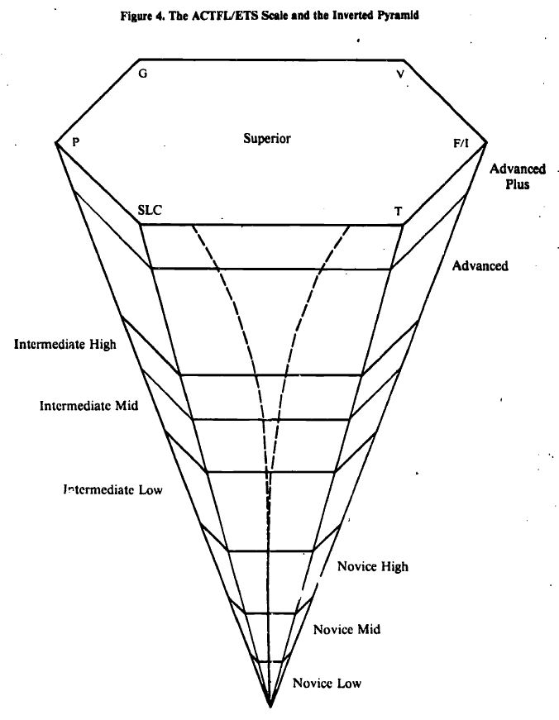
Origins of the Inverted Pyramid
Lowe 1985b
ATSEEL 2020: Corin
Notes:
The evolution of the depiction of the inverted pyramid continues in this preliminary depiction of the ACTFL inverted pyramid published by Lowe (1985b, one year before the official “promulgation” of the ACTFL Proficiency Guidelines). This depiction was presumably authored within the context of the joint academic/USG committee that developed the original “official” (1986) ACTFL Proficiency Guidelines.
Note the de-emphasizing of the presumed exponential rate of proficiency development. The reason for this is not discussed, but…
This feature may be related to one striking difference between the USG (ILR) and academic (ACTFL) conceptions; emphasis on upper (USG) vs. lower (academic) ranges of proficiency.
This difference was acknowledged (within the committee, presumably) as recognizing the differing realities and requirements at the time between these two broad environments (viz., USG and academia/education). Halleck (1990, 49), Liskin-Gasparro (1984, 477-478), Lowe (1983, 232-233; 1985b, 13, 32).
The ACTFL scale provided more granularity at the lower levels of proficiency, while the FSI/ILR scale focused more on the upper ranges of proficiency.
The ACTFL scale originally indicated Superior as a ceiling, rather than a range. Later (2012), Distinguished was (re-)added, but again as a ceiling, rather than a range, with Superior not broken down into sub-ranges, as is the case with the lower proficiency levels. In contrast to this, ILR recognizes (not unproblematical, to be sure) Levels 4 and 5, with intermediate testing results possible at Levels 3+ and (potentially?) 4+.
Literature:
Halleck, Gene Bronstein. (1990). Assessing the oral proficiency of Chinese speakers of English as a Foreign Language: Holistic rating versus the objective measure of syntactic maturity. Pennsylvania State University doctoral dissertation.
Liskin-Gasparo, Judith E. (1984). “The ACTFL Proficiency Guidelines: Gateway to Testing and Curriculum.” Foreign Language Annals; Oct 1, 1984; 17(5), 475-489.
Lowe, Pardee, Jr. (1983). Pardee Lowe, Jr. (1983). The ILR Oral Interview: Origins, Applications, Pitfalls, and Implications. Die Unterrichtspraxis / Teaching German, Vol. 16, No. 2, pp. 230-244. Stable URL: https://www.jstor.org/stable/3530138
Lowe, Pardee, Jr. (1985b). “The ILR Proficiency Scale as a Synthesizing Research Principle: The View from the Mountain.” In James, Charles J., Ed. (1985). Foreign Language Proficiency in the Classroom and Beyond. Lincolnwood, Illinois: National Textbook Company (in conjunction with the American Council on the Teaching of Foreign Languages), pp. 9-54.

Slide 30
Inverted Pyramid Today: ACTFL
https://www.actfl.org/publications/guidelines-and-manuals/actfl-proficiency-guidelines-2012
ATSEEL 2020: Corin
Notes:
This brings up to the present ACTFL depiction of the inverted pyramid (or to graphically equivalent intermediate representations, as, for example, in Halleck, 1990, 144).* We can note:
The subsequent inclusion of the “Distinguished” level, which corresponds to ILR 4 and higher.
The Distinguished level is now indicated as a ceiling, while Superior is now indicated as a volume.
The Superior level is not divided into “low,” “mid” and “high” sub-levels.
The facets of the pyramid are no longer labeled. No significance of the six facets is indicated.
*An interesting “hybrid” drawing is presented by Liskin-Gasparro (1984, 477), in which she presents all six ILR ranges (0, 1, 2, 3, 4, 5), but labeled with the ACTFL designations (Novice, Intermediate, Advanced, Superior). The upper three ILR ranges are bracketed together and are collectively named “Superior.”
Literature:
“General Preface to the ACTFL Proficiency Guidelines 2012.” Retrieved from: https://www.actfl.org/publications/guidelines-and-manuals/actfl-proficiency-guidelines-2012
Halleck, Gene Bronstein. (1990). Assessing the oral proficiency of Chinese speakers of English as a Foreign Language: Holistic rating versus the objective measure of syntactic maturity. Pennsylvania State University doctoral dissertation.
Liskin-Gasparo, Judith E. (1984). “The ACTFL Proficiency Guidelines: Gateway to Testing and Curriculum.” Foreign Language Annals; Oct 1, 1984; 17(5), 475-489.

Slide 31
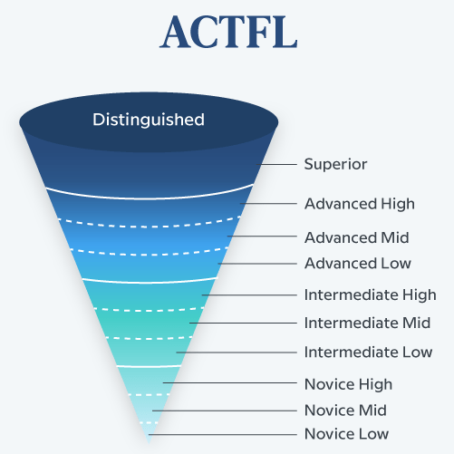
Inverted Pyramid Today: Lyons (2018)
https://www.babbel.com/en/magazine/how-and-why-to-determine-language-proficiency
ATSEEL 2020: Corin
Notes:
This depiction, as can be seen, explicitly ascribes its conception to ACTFL.
Nevertheless, it appears to recognize, or suggest, implicitly (I found no discussion of this at the Babbel site, nor references to such discussion) that the ACTFL six-faceted depiction is no longer motivated. The author has therefore (presumably) taken the initiative to remove this suggestion/implication of exactly six facets of (i.e., domains of performance relevant to) language proficiency.
Literature:
Lyons, Dylan. (2018). “How (And Why) To Determine Your Level Of Language Proficiency.” Babbel Magazine. < https://www.babbel.com/en/magazine/how-and-why-to-determine-language-proficiency>.

Slide 32
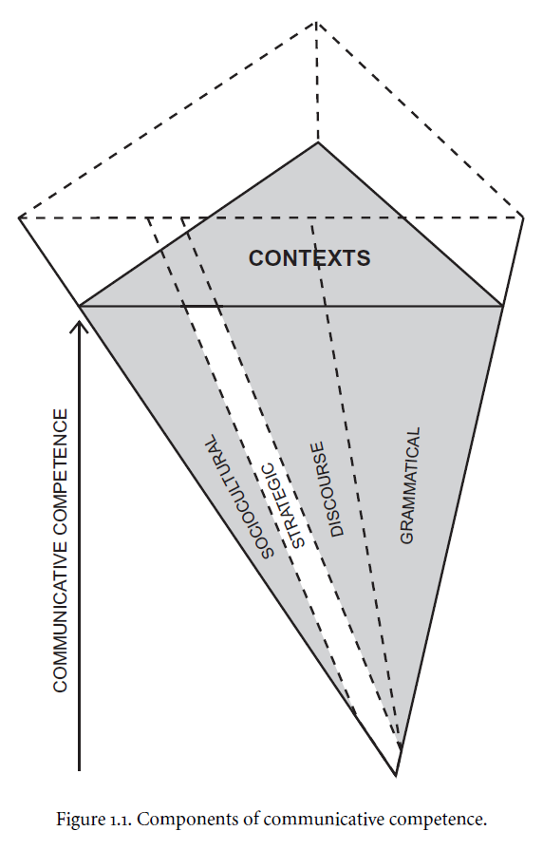
Origins of the Inverted Pyramid
Savignon 1983
Savignon 1997
Savignon 2002
ATSEEL 2020: Corin
Notes:
This depiction of an inverted pyramid was proposed in Savignon (1983). It appears to have arisen independently of the representation proposed originally by Clifford which evolved into the current ACTFL depiction.
It fits into a conception of communicative competence that parallel’s that of proficiency.
This inverted pyramid is three-faceted. As is readily discernable, the facets of Savignon’s inverted pyramid of communicative competence have some similarities (“grammatical” and “sociocultural” facets) to those of Clifford’s inverted pyramid of language proficiency. There are also significant differences. In Savignon’s conception, “contexts” are indicated in an intersecting dimension, while it is not entirely clear how her facets relate to those of Clifford’s model, except perhaps in regard to “sociocultural.”
One striking characteristic of Savignon’s model with which we might strongly disagree today is that related to “strategic” competence. Savignon considered this to be one area in which learners began language study already with, or quickly developed, those strategies that would serve them throughout their study. There is, however, a significant body of literature (originating no later than the 1970s in regard to cognitive style and other aspects of learning style in general education that has direct relevance to L2 learning), which argues for an opposite approach (or which implies an opposite approach), emphasizing the need for learners to develop an ever broader range of strategies in order to achieve ever higher levels of L2 proficiency, but especially in order to achieve ILR 3 (Superior) and especially ILR 4 (Distinguished) proficiency.
Literature (add Messick, Ramirez et al., Oxford and Leaver):
Savignon, S. (1983). Communicative competence: Theory and classroom practice. Reading, MA: Addison-Wesley,
Savignon, S. (1997). Communicative competence: Theory and classroom practice (2nd ed.). New York: McGraw-Hill.
Savignon, Sandra J., ed. (2002). “Communicative Language Teaching: Linguistic Theory and Classroom Practice.” In Savignon, Sandra J., ed. Interpreting Communicative Language Teaching: Contexts and Concerns in Teacher Education. New Haven, CT: Yale University Press, 1-27.

Slide 33
The Inverted Pyramid:
Key Questions
Origin & History of the Inverted Pyramid Concept
What is the Inverted Pyramid “of”?
  Quantity of content/learning?
  Time to next proficiency level?
What is the Inverted Pyramid’s Shape?
  How many sides does/should it have?
  Is its shape regular?
  What is its slope: arithmetic, exponential, …?
Does the Inverted Pyramid Even Exist? (Validation)
What causes the Inverted Pyramid?
What can we do about it?
ATSEEL 2020: Corin
Notes:
The discussion of these two questions is explicated through the following slide.

Slide 34
What is the Inverted Pyramid?
Expanding Quantity of:
  Learning?
  Time?
Shape of the Inv. Pyramid
  Facets?
  Regularity?
  Slope/Acceleration:
    Arithmetic?
    Exponential?
    Universal & Constant?
ATSEEL 2020: Corin
Notes:
Expanding quantity of content/learning vs. expanding quantity of time: both concepts have been invoked since the origin of the concept. The straightforward assumption would be that expanding quantities of content/learning imply expanding time-to-next-proficiency-level, but this is not obvious. Other explanations are possible:
Vincent: suggests an inverted pyramid of both “difficulty” (apparently implying content/learning) and time to proficiency level
Clifford, Lowe and original ACTFL inverted pyramid: these are labeled to describe an expanding quantity of content/learning, and appear to imply expanding time-to-next proficiency-level
Current ACTFL inverted pyramid: this depiction is unspecified in this regard
Number and identity of facets: this depends on one’s conception as to how many performance domains contribute to global proficiency in any given skill (L/R/S/W)
Clifford and Lowe’s conception worked with six domains of oral proficiency
Other conceptions include the functional trisection of oral proficiency (note the relation of this conception to that of the three-faceted characteristic of criterion-referenced tests; see Clifford, 2016) and quintasection of reading proficiency (discussed, e.g., by Lowe 1985a, 1985b), and Savignon’s conception (add citations).
Regularity (symmetry) of the pyramid’s shape: this has been largely assumed, and has apparently not been systematically researched. No reason has been suggested for this to be assumed. In fact, there is a considerable body of experience suggesting that typically (not universally!), reading tends to develop faster than listening, with speaking lagging behind both (e.g., long DLIFLC experience, inter alia encoded into the graduation requirement of 2/2/1+). Should this be factored into the inverted pyramid shape?
Slope:
Some research and non-systematic observations suggest something like exponential growth (claimed explicitly by Vincent and adopted by Lowe), but results to date are limited and mixed.
It is an assumption that the slope and its acceleration (if any) remain constant. One could conceive of other shapes: e.g., first expanding then contracting. The limited amount of research into the attainment of superior and distinguished proficiency levels makes it difficult to state anything concrete about this. However, the results of Davidson and Shaw (2019) suggest that this latter possibility (first gradual expansion between Levels 0+ and 2), then contraction (between Levels 2 and 3) of time to next proficiency level) may be a reality, at least in the particular context that they examined. It should be borne in mind that they attempted to explain their results in terms of the inverted pyramid hypothesis of ever-expanding difficulty to achieve successive proficiency levels. They thus suggested that, in some sense, readiness for achievement of higher levels may be offsetting the actual difficulty of reaching ever higher levels (though they don’t use quite these words). In other words, the learner who is trying to move from ILR 2 (Advanced ) to ILR 3 (Superior) is no longer the same learner who previously attempted to move from ILR 0/0+ (Novice) to ILR 1 (Intermediate) and on to ILR 2 (Advanced). Presumably this conception, if further articulated, would view these more advanced learners as having an expanded learning capacity in multiple respects (e.g., learning strategies that span the range of those typical of learners with opposite “native” learning styles, or expanded sociocultural awareness and competencies; this is, incidentally, precisely why we question Savignon’s depiction of strategic competence as not expanding at successive proficiency levels). If this is true, it might mean that there is, after all, no direct and inevitable correlation between the two senses of the inverted pyramid; that is, time-to-next-proficiency-level may not be inevitably directly proportional to the amount of learning (however measured) that separates each proficiency level from the next higher proficiency level. There is, of course, yet another possible explanation: that the approaches to learning utilized in the study-abroad programs that were examined by Davidson and Shaw may share certain characteristics with the type of open architecture curricular model that, according to our hypothesis, should be useful in overcoming the inverted pyramid. Other cohort results reported by Davidson and Shaw (p. 232) do seem to show the inverted pyramid as continuing into the ILR 2 – 3 (Advanced to Superior) learning range, but the smaller delta for students with incoming ILR 2 (Advanced) proficiency in relation to the deltas for students with incoming ILR 0+ – 1+ (Novice – Intermediate) is relatively small, in no sense “exponential,” and does not bring into question the explanations suggested for the previous data.
It is an assumption (i.e., it is not obvious) that the inverted pyramid (if any) is a universal of L2 learning. To the contrary, it is not only possible but probable that it depends in part on individual learner variables (e.g., the tortoises and hares effect; see below) as well as on instructional/curricular approaches. The latter is in fact the main topic of this paper.
Lowe (1985b, p. 25): “A complicating factor in discussing the scale is its exponential growth, which Vincent (57) established through a study in psychophysical scaling with Language School raters and which Clifford depicts graphically in his Inverted Pyramid (Figure 3).”
A further issue: does the inverted pyramid apply equally and have equal shape and other parameters, regardless of the languages involved (both L1 and L2)? There is a small amount of literature that suggests that this may not be the case, at least universally. The LTI Site (< https://www.languagetesting.com/how-long-does-it-take >) gives one indication that there might be a less than perfectly shaped (neither entirely linear not entirely exponential) inverted pyramid, though it provides a complete comparison (i.e., Int Low > Adv Low > Superior) only for Level 4 languages for learners with average aptitude, with no indication (other than a reference) as to how measurements (including aptitude) were taken. The reference provided is to “Judith E. Liskin-Gasparro. ETS Oral Proficiency Testing Manual. Princeton, N.J.: Educational Testing Service, 1982.”
Literature (partial)
Clifford, Ray. (2016). A Rationale for Criterion-Referenced Proficiency Testing. Foreign Language Annals, 49(2), 224–234. DOI: 10.1111/flan.12201
Davidson, Dan E., & Jane Robin Shaw. (2019). A Cross-Linguistic and Cross-Skill Perspective on L2 Development in Study Abroad. In: P. Winke, & S. Gass, (Eds.), Foreign Language Proficiency in Higher Education (pp. 217-242). Springer, Cham. (Educational Linguistics, vol. 37). https://doi.org/10.1007/978-3-030-01006-5_12

Slide 35
The Inverted Pyramid:
Key Questions
Origin & History of the Inverted Pyramid Concept
What is the Inverted Pyramid “of”?
  Quantity of content/learning?
  Time to next proficiency level?
What is the Inverted Pyramid’s Shape?
  How many sides does/should it have?
  Is its shape regular?
  What is its slope: arithmetic, exponential, …?
Does the Inverted Pyramid Even Exist? (Validation)
What causes the Inverted Pyramid?
What can we do about it?
ATSEEL 2020: Corin
Notes:
See the following slide for notes.

Slide 36
Does the Inverted Pyramid Exist:
Validation
Impressions Based on Experience: Lowe (1985a, 1985b
Studies on Gains During Classroom Instruction
  Vincent (1978), Meredith (1990)
Studies based on Gains During Study Abroad
  Brecht, et al. (1993, 1995), Davidson & Shaw (2019)
Studies Indirectly Suggestive of Inverted Pyramid
  Carroll (1967), Watzinger-Tharp et al. (2018), Winke et al. (2019)
Valid (& Similar) for All Learners: Tortoises & Hares
Valid (& Similar) for All Language Pairs
How Do We Measure Time to Proficiency Level
Is the Inverted Pyramid an Artifact?
ATSEEL 2020: Corin
Notes:
Generally, the research is limited.
Three types of studies have suggested some form of validation:
Studies in connection with classroom instruction at the home institution: Vincent (1978), Meredith (1990).
Studies in connection with proficiency attainment during study abroad programs: Brecht, Davidson & Ginsberg (1993, 1995); Davidson and Shaw (2019); (possibly bring in Reschke, 1984 and Liskin-Gasparro, 1987).
Studies that are indirectly suggestive of an inverted pyramid by showing that even among undergraduate language majors, few reach ILR 3 (Superior) or above during a four-year degree program: Carroll (1967); Watzinger-Tharp, Rubio, and Tharp (2018); Winke, Gass, & Heidrich (2019.
[Note also the (equally limited) literature criticizing the concept of the inverted pyramid, e.g., Lantolf & Frawley (1985). By now this is largely dated.]
One question: does the inverted pyramid exist for (almost) all learners, or is it a tendency that is manifested in many learners but not in others? The tortoises and hares phenomenon (Leaver, multiple publications, e.g., Leaver & Corin, in press), taken together with Davidson and Shaw’s (2019) finding of an expanding- then contracting-shaped curve of proficiency gain by level during study abroad, suggests the need for further study.
Another issues: does the inverted pyramid apply equally, having identical shape and other parameters, regardless of the languages involved (both L1 and L2)? There is a small amount of literature that suggests that this may not be the case.
Yet another issue: how does one measure or quantify time-to-next-proficiency-level? Knowing when a learner attained particular proficiency levels is difficult in the extreme. Moreover, how does one measure time to proficiency level? Should one look at calendar time, course hours, or actual time-on-task? Should one take into consideration gaps between courses, intensity of study (e.g., taking multiple course vs. just one course during a particular term, 5 day per week courses differently from 3 day per week courses, in-country activities differently from home institution activities; should we factor in out-of-class course-related activities [e.g., homework or personal initiative]; how does one quantify time on task during study abroad?). Decisions are required. Also, does one (or, how does one) factor in the “in-between” (“plus” or “low vs. mid vs. high”) ratings? Etc.
Literature:
Brecht, Richard, Davidson, Dan, & Ginsberg, Ralph B. (1993). Predictors of Foreign Language Gain during Study Abroad. The National Foreign Language Center and the American Council of Teachers of Russian. (NFLC Occasional Papers.)
Brecht, R., Davidson, D., & Ginsberg, R. (1995). Predictors of foreign language gain during study abroad. In B. F. Freed (Ed.), Second language acquisition in a study abroad context (pp. 37–66). Amsterdam, Netherlands: John Benjamins.
Carroll, John B. (1967). Foreign Language Attainments of Language Majors in the Senior Year: A Survey Conducted in U.S. Colleges and Universities (Cambridge, Mass.: Harvard University.
Davidson, Dan E. and Shaw, Jane Robin. (2019). “A Cross-Linguistic and Cross-Skill Perspective on L2 Development in Study Abroad.” In: Winke P., Gass S. (eds) Foreign Language Proficiency in Higher Education, 217-242. Educational Linguistics, vol 37. Springer, Cham. https://doi.org/10.1007/978-3-030-01006-5_12
Lantolf, J. P. and W. Frawley. (1985). “Oral proficiency testing: A critical analysis.” The Modern Language Journal, 69: 337-345.
Leaver, Betty Lou & Corin, Andrew R. (in press). Fields of the Mind: An Integral Learning Styles Component of the E&L Cognitive Styles Construct. Russian Language Journal.
Liskin-Gasparro, Judith E. (1982). ETS Oral Proficiency Testing Manual. Princeton, N.J.: Educational Testing Service.
Liskin-Gasparro, Judith. (1987). Testing and Teaching for Oral Proficiency. Boston: Heinle.
Meredith, Alan. (1990). “The Oral Proficiency Interview in Real Life: Sharpening the Scale.” The Modern Language Journal, Vol. 74, No. 3 (Autumn, 1990), pp. 288-296. https://www.jstor.org/stable/327625
Vincent, Robert. (1978). Vincent, Robert J. "Psychophysical Scaling of the Language Proficiency Interview: A Preliminary Report," pp. 229-53, in John L. D. Clark, ed., Direct Testing of Speaking Proficiency: Theory and Application. Proceedings of a Two-Day Conference conducted by Educational Testing Service in cooperation with the U.S. Interagency Language Roundtable and the Georgetown University Round Table on Languages and Linguistics, March 1978.
Watzinger-Tharp, Johanna, Rubio, Fernando, and Tharp, Douglas S. (2018). “Linguistic performance of dual language immersion students. Foreign Language Annals 51:575–595. https://doi.org/10.1111/flan.12354
Winke, Paula, Gass, Susan M., and Heidrich, Emily S. (2019). “Modern-Day Foreign Language Majors: Their Goals, Attainment, and Fit Within a Twenty-First Century Curriculum.” In Winke, Paula and Gass, Susan M., Eds. (2019). Foreign Language Proficiency in Higher Education. Cham, Switzerland: Springer Nature Switzerland AG, 93-113. https://doi.org/10.1007/978-3-030-01006-5_6
The last point takes us to the next slide…

Slide 37
The Inverted Pyramid:
Key Questions
Origin & History of the Inverted Pyramid Concept
What is the Inverted Pyramid “of”?
  Quantity of content/learning?
  Time to next proficiency level?
What is the Inverted Pyramid’s Shape?
  How many sides does/should it have?
  Is its shape regular?
  What is its slope: arithmetic, exponential, …?
Does the Inverted Pyramid Even Exist? (Validation)
What causes the Inverted Pyramid?
What can we do about it?
ATSEEL 2020: Corin
Notes:
See following slide for notes.

Slide 38
What Causes the Inverted Pyramid
Ever Greater Amount of Learning?
  Sociocultural Competencies
Higher Proficiency Levels Progressively Less Compensatory
Learner Variables
  Readiness for Learning?
  Cognitive Style, Personality, etc.
  Strategy Inventory (Affected by Instructional Approach)
Approaches to Instruction and Curriculum
  Differences between High and Low Level Learning
  Linear Scope and Sequence (non-inverted pyramid)
ATSEEL 2020: Corin
Notes:
Answer 1: in line with the common conception, an ever greater quantity of “learning” (however measured) that must be achieved in order to proceed through successive levels of proficiency;
Answer 2: beyond the (presumably) ever greater sheer quantity of learning, the progressively less compensatory nature of ever higher levels of proficiency. To the extent that this is true, this is one area in which possibilities for treatment to counteract the inverted pyramid are inevitably limited. This appears to be part of the significance of the box that encloses the lower ranges of proficiency in Lowe’s 1985b depiction of the ILR inverted pyramid. This box distinguishes the “partially compensatory” lower levels of proficiency from the upper “non-compensatory” (ILR 3 and above) levels. See Lowe (1985b, pp. 20-25, also cited earlier in the presentation): “Earlier both Lowe … and Clifford … had questioned the traditional set of five Foreign Service Institute factors and the way in which they had been regarded as contributing to the global score. Lowe referred to them as the static model since the now abandoned weighting table statically applied the weightings of the Level 2+/3 border to all levels throughout the scale. Clifford proposed a dynamic model which would recognize the uniquely noncompensatory nature of the ILR scale's upper end (Level 3 and higher) and the gradually more compensatory nature of Level 2+ downwards. He also pointed out that even at the lower end, a noncompensatory core exists. (See Figure 5.) The noncompensatory core means that despite the fact that Levels 0+ through 2+ often permit compensation, strong vocabulary may offset weaker grammar, some features remain essential and may not be compensated for.”
Answer 3: learner Variables (implies the potential significance of cohort variables as well)
Readiness for learning issues: some of these may be ephemeral, others stable over time (e.g., Achterberg, 1988).
Cognitive style and related matters: it is possible that learners with different individual profiles may have entirely differently shaped “inverted pyramids”; for some learners the shape of the curve of progression from one proficiency level to the next may not look like an inverted pyramid at all. To use Leaver’s metaphor (add citations to literature, including Leaver, 1986; Leaver, Ehrman & Shekhtman, 2009; Leaver and Corin, in press; Corin and Leaver, forthcoming, current draft p. 70), “hares” (typically, synoptic learners) may have an exaggerated inverted pyramid, while “tortoises” (typically ectenic learners) may have no inverted pyramid at all, perhaps even a progression more akin to a non-inverted pyramid.
Answer 4: instructional and curricular approaches (not independent of learner variables, to be sure):
Instruction: instructors’ or course developers’ insufficient awareness of differences between learning at lower and higher levels of proficiency;
Curriculum: linear scope and sequence, which creates a non-inverted pyramid of exposure to, and time-on-task with, ever higher-level text and task types and associated linguistic/paralinguistic elements.
Some literature related to tortoises and hares:
Achterberg, C. (1988). Factors that influence learner readiness. Journal of the American Dietetic Association [01 Nov 1988, 88(11):1426-1428].
Corin, Andrew R. & Leaver, Betty Lou. (forthcoming). Fields of the Mind: History, Theory, & Application of Cognitive Field Concepts to Language Learning. MSI Press.
Leaver, B. L. (1986) “Hemisphericity of the brain and foreign-language teaching.” Folia Slavica 8, 76–90.
Betty Lou Leaver, Madeline Ehrman , Boris Shekhtman. (2005 print/2009 electronic). Achieving Success in Second Language Acquisition. Cambridge University Press. See pp. 235-236. https://doi.org/10.1017/CBO9780511610431
Leaver, Betty Lou & Corin, Andrew R. (in press). Fields of the Mind: An Integral Learning Styles Component of the E&L Cognitive Styles Construct. Russian Language Journal.
Leaver, Betty Lou, Ehrman, Madeline, & Shekhtman, Boris. (2005 print/2009 electronic). Achieving Success in Second Language Acquisition. Cambridge University Press. https://doi.org/10.1017/CBO9780511610431
Davidson, Dan E., Garas, Nadra, & Lekic, Maria D. (in press). Transformative Language Learning in the Overseas Immersion Environment: Exploring Affordances of Intercultural Development. In Betty Lou Leaver, Dan Davidson & Christine Campbell, (Eds.), Transformative Language Learning and Teaching. Submitted to Cambridge University Press. [See section on IDI.]
Lowe, Pardee, Jr. (1985b). “The ILR Proficiency Scale as a Synthesizing Research Principle: The View from the Mountain.” In James, Charles J., Ed. (1985). Foreign Language Proficiency in the Classroom and Beyond. Lincolnwood, Illinois: National Textbook Company (in conjunction with the American Council on the Teaching of Foreign Languages), pp. 9-54.
Numerous further relevant items of literature may be added, particularly in regard to learner individuality.

Slide 39
The Inverted Pyramid:
Key Questions
Origin & History of the Inverted Pyramid Concept
What is the Inverted Pyramid “of”?
  Quantity of content/learning?
  Time to next proficiency level?
What is the Inverted Pyramid’s Shape?
  How many sides does/should it have?
  Is its shape regular?
  What is its slope: arithmetic, exponential, …?
Does the Inverted Pyramid Even Exist? (Validation)
What causes the Inverted Pyramid?
What can we do about it?
ATSEEL 2020: Corin
Notes:
This slide brings us full circle: back to our original issue discussed in the first several slides. See notes to following slide.

Slide 40
What Can We Do About the Inverted Pyramid?
Leverage Awareness of Learner & Cohort Individuality
  Build Strategy Competency (Accommodation & Confrontation):
    Hare-Like Tortoises
    Tortoise-Like Hares
Address Requirements of Learning to Higher Levels
  Accuracy: Address Progressively
  Discourse and Sociocultural Competencies
  Strategy Ambidexterity
Curriculum: Time-on-Task w/ Higher-Level Tasks, etc.
ATSEEL 2020: Corin
Notes:
This slide brings us full circle: back to our original issue discussed in the first several slides. Based on the preceding, there appear to be at least two general approaches, and a variety of specific treatments based on them, either individually or in combination. One is related to instruction, the other to curriculum.
Instruction: employ diagnostic instruction at all proficiency levels:
Incorporate awareness of learner and cohort individuality and adapt based on them. Leverage personality, cognitive style, sensory preferences, motivational profile, educational and personal biographical background. Treat through both accommodational and confrontational (e.g., strategy-building) approaches.
Strategy building to create hare-like tortoises and tortoise-like hares.
Ensure awareness of, and gradual adaptation to, requirements of learning to achieve upper ranges (3 – 4; e.g., accuracy and sociocultural competence) that differ from those needed to achieve lower ranges (0+ – 2) and build those gradually to avoid a “wall of fossilization” at around ILR 2 for some learners.
Curriculum and Instruction/Curriculum interface:
Use of and, preferably, reliance on authentic materials, engagement of critical thinking and HOTS, task-, scenario-, project- and content-based learning and immersive (TL-only) environment as early as possible, including FROM DAY 1. All of these approaches counteract the non-inverted pyramid of exposure to and time on task with ever higher-level text and task types and the linguistic and paralinguistic elements typically associated with them..
Incorporate or transition to open architecture curriculum with vertical spiraling ASAP, to promote the measures listed under the previous point which can counteract the non-inverted pyramid of exposure to ever higher-level text and task types. The modular open-architecture SBI and SBI-CBI approaches illustrated in this presentation were designed in part to accomplish these goals.
.

Slide 41
References (1)
Achterberg, C. (1988). Factors that Influence Learner Readiness. Journal of the American Dietetic Association, 88(11), 1426-1428.
Brecht, Richard, Davidson, Dan, & Ginsberg, Ralph B. (1993). Predictors of Foreign Language Gain during Study Abroad. The National Foreign Language Center and the American Council of Teachers of Russian. (NFLC Occasional Papers.)
Brecht, Richard, Davidson, Dan, & Ginsberg, Ralph B. (1995). Predictors of Foreign Language Gain during Study Abroad. In B. F. Freed, (Ed.), Second Language Acquisition in a Study Abroad Context (37–66). Amsterdam, Netherlands: John Benjamins.
Campbell, C., Corin, A., Kanbar, H. & Leaver, B. L. (2017). “Pushing the Envelope: Transformative Pedagogy in Outcomes-Based FL Instruction,” Tenth International Conference on Language Teacher Education, University of California, Los Angeles.
Carroll, John B. (1967). Foreign Language Attainments of Language Majors in the Senior Year: A Survey Conducted in U.S. Colleges and Universities. Cambridge, Mass.: Harvard University.
Clifford, Ray. (1980). Testing Oral Language Proficiency: A Dynamic Model. Unpublished paper presented at the Second Language Testing Symposium of the Interuniversitäre Sprachtestgruppe, Darmstadt, Germany, May 1980. (Cited from Lowe, 1985a, 1985b)
ATSEEL 2020: Corin

Slide 42
References (2)
Clifford, Ray. (2016). A Rationale for Criterion-Referenced Proficiency Testing. Foreign Language Annals, 49(2), 224–234. DOI: 10.1111/flan.12201
Corin, Andrew R. (1997). A Course to Convert Czech Proficiency to Proficiency in Croatian and Serbian. In S. B. Stryker & B. L. Leaver, (Eds.), Content-Based Instruction in Foreign Language Education: Models and Methods (pp. 78-104). Washington, D.C.: Georgetown
Corin, Andrew R. (2008a). Mission Impossible: 40 Novice Students, No Materials, Untrained Instructors, 10 Weeks until DLPT (Serbian – Croatian 1993). PowerPoint presentation delivered at the Defense Language Institute Foreign Language Center, School of European and Latin American Studies, 3 June 2008.
Corin, Andrew R. (2008b). Lessons of the 1993 Serbian – Croatian Conversion Course (Mission Impossible Continued). PowerPoint presentation delivered at the Defense Language Institute Foreign Language Center, School of European and Latin American Studies, 26 June 2008.
Corin, Andrew R. (in press). Foreign Language Learning Efficiency: Transformative Learning in an Outcomes-Based Environment. In Betty Lou Leaver, Dan Davidson & Christine Campbell, (Eds.), Transformative Language Learning and Teaching. Submitted to Cambridge University Press.
Corin, Andrew R. & Leaver, Betty Lou. (forthcoming). Fields of the Mind: History, Theory, & Application of Cognitive Field Concepts to Language Learning. MSI Press.
ATSEEL 2020: Corin

Slide 43
References (3)
Dababneh, R. (2018). The scenario-based syllabus for the post-basic Arabic program. Dialog on Language Instruction, 28(1), pp. 13-26.
Davidson, Dan E., Garas, Nadra, & Lekic, Maria D. (in press). Transformative Language Learning in the Overseas Immersion Environment: Exploring Affordances of Intercultural Development. In Betty Lou Leaver, Dan Davidson & Christine Campbell, (Eds.), Transformative Language Learning and Teaching. Submitted to Cambridge University Press.
Davidson, Dan E., & Jane Robin Shaw. (2019). A Cross-Linguistic and Cross-Skill Perspective on L2 Development in Study Abroad. In: P. Winke, & S. Gass, (Eds.), Foreign Language Proficiency in Higher Education (pp. 217-242). Springer, Cham. (Educational Linguistics, vol. 37). https://doi.org/10.1007/978-3-030-01006-5_12
General Preface to the ACTFL Proficiency Guidelines 2012. Retrieved from: https://www.actfl.org/publications/guidelines-and-manuals/actfl-proficiency-guidelines-2012
Halleck, Gene Bronstein. (1990). Assessing the Oral Proficiency of Chinese Speakers of English as a Foreign Language: Holistic Rating versus the Objective Measure of Syntactic Maturity. Pennsylvania State University doctoral dissertation.
Lantolf, J. P. and W. Frawley. (1985). Oral Proficiency Testing: A Critical Analysis. The Modern Language Journal, 69, 337-345.
ATSEEL 2020: Corin

Slide 44
References (4)
Leaver, Betty Lou. (1986) Hemisphericity of the Brain and Foreign-Language Teaching. Folia Slavica, 8, 76–90.
Leaver, Betty Lou & Corin, Andrew R. (in press). Fields of the Mind: An Integral Learning Styles Component of the E&L Cognitive Styles Construct. Russian Language Journal.
Leaver, Betty Lou, Ehrman, Madeline, & Shekhtman, Boris. (2005 print/2009 electronic). Achieving Success in Second Language Acquisition. Cambridge University Press. https://doi.org/10.1017/CBO9780511610431
Liskin-Gasparro, Judith E. (1982). ETS Oral Proficiency Testing Manual. Princeton, N.J.: Educational Testing Service.
Liskin-Gasparo, Judith E. (1984). The ACTFL Proficiency Guidelines: Gateway to Testing and Curriculum. Foreign Language Annals, 17(5), 475-489.
Liskin-Gasparro, Judith. (1987). Testing and Teaching for Oral Proficiency. Boston: Heinle.
Lowe, Pardee, Jr. (1983). The ILR Oral Interview: Origins, Applications, Pitfalls, and Implications. Die Unterrichtspraxis / Teaching German, 16(2), 230-244. Stable URL: https://www.jstor.org/stable/3530138
ATSEEL 2020: Corin

Slide 45
References (5)
Lowe, Pardee, Jr. (1985a). Proficiency-Based Curriculum Design: Principles Derived from Government Experience. Die Unterrichtspraxis / Teaching German, 18(2), 233-245. Retrieved from https://www.jstor.org/stable/3530456
Lowe, Pardee, Jr. (1985b). The ILR Proficiency Scale as a Synthesizing Research Principle: The View from the Mountain. In Charles J. James (Ed.), Foreign Language Proficiency in the Classroom and Beyond (pp. 9-54). Lincolnwood, Illinois: National Textbook Company (in conjunction with the American Council on the Teaching of Foreign Languages).
Lyons, Dylan. (2018). How (And Why) To Determine Your Level Of Language Proficiency. Babbel Magazine. Retrieved from: https://www.babbel.com/en/magazine/how-and-why-to-determine-language-proficiency
Meredith, Alan. (1990). The Oral Proficiency Interview in Real Life: Sharpening the Scale. The Modern Language Journal, 74(3), 288-296. https://www.jstor.org/stable/327625
Savignon, Sandra J. (1983). Communicative Competence: Theory and Classroom Practice. Reading, MA: Addison-Wesley, (2nd ed. New York: McGraw-Hill, 1997)
ATSEEL 2020: Corin

Slide 46
References (6)
Savignon, Sandra J. (2002). Communicative Language Teaching: Linguistic Theory and Classroom Practice. In Sandra J. Savignon, (Ed.), Interpreting Communicative Language Teaching: Contexts and Concerns in Teacher Education (pp. 1-27). New Haven, CT: Yale University Press.
Tarone, E. (2017). Exploring Learner Language in Language Teacher Education. Pre-conference workshop at the Tenth International Conference on Language Teacher Education, University of California, Los Angeles, February 2, 2017.
Vincent, Robert J. (1978). Psychophysical Scaling of the Language Proficiency Interview: A Preliminary Report. In John L. D. Clark, (Ed.), Direct Testing of Speaking Proficiency: Theory and Application (pp. 229-53). Proceedings of a Two-Day Conference conducted by Educational Testing Service in cooperation with the U.S. Interagency Language Roundtable and the Georgetown University Round Table on Languages and Linguistics, March 1978.
Watzinger-Tharp, Johanna, Rubio, Fernando, & Tharp, Douglas S. (2018). Linguistic Performance of Dual Language Immersion Students. Foreign Language Annals 51, 575–595. https://doi.org/10.1111/flan.12354
Winke, Paula, Gass, Susan M., & Heidrich, Emily S. (2019). Modern-Day Foreign Language Majors: Their Goals, Attainment, and Fit Within a Twenty-First Century Curriculum. In Paula Winke & Susan M. Gass, (Eds.), Foreign Language Proficiency in Higher Education (pp. 93-113). Cham, Switzerland: Springer Nature Switzerland AG. https://doi.org/10.1007/978-3-030-01006-5_6
ATSEEL 2020: Corin

Slide 48
Open Architecture Curriculum for Students at Novice - Advanced Levels
AATSEEL 2020
Irene Krasner Professor
Defense Language Institute Foreign Language Center irene.krasner@dliflc.com

Slide 49
DISCLAIMER:
This presentation is authorized by the Defense Language Institute Foreign Language Center and the Department of Defense. Contents of this presentation are not necessarily the official views of, or endorsed by, the U.S. Government, or the Department of the Army. All material displayed within this presentation is for educational purposes only. All third party information featured in the presentation slides remain the intellectual property of their respective originators.

Slide 50
DISCLAIMER:
All use of information is done under the fair use copyright principal, and the author(s) of this presentation do not assert any claim of copyright for any quotation, statistic, fact, figure, data or any other content that has been sourced from the public domain. The content of this presentation is the sole responsibility of Irene Krasner.

Slide 51
Presentation Outline
Examples of DLIFLC OACD Courses.
Challenges in Applying OACD to Novice - Advanced Levels in Inflective Languages. Gradual Transition to from a Linear Scope and Sequence to OACD.
Innovative Skill-Integrated Model of OACD.
Application of the Model to Teaching Lower Level Russian Courses.
Innovative Model of Alternative Assessments at Novice-Advanced Levels.

Slide 52
DLIFLC Basic Courses
Implementing OACD
Hebrew Basic course (47 wks.) uses excerpts from commercial textbooks for basic grammar concepts in the 1st semester.
French Basic course (36 wks.) uses two commercial books 1-2 hrs. a day for basic grammar in the 1st and 2nd semesters.
The rest of the courses is recreated by faculty for every student group.

Slide 53
DLIFLC OACD Russian Basic Course Projects at Levels 2-3
Russian Basic Course authentic materials collection “Russia Today” (first version 2006).
Nine books (720 pgs.): Supplements for Modules 7, 8, 9 in listening and reading comprehension – (project manager- Prof. Krasner).

Slide 54
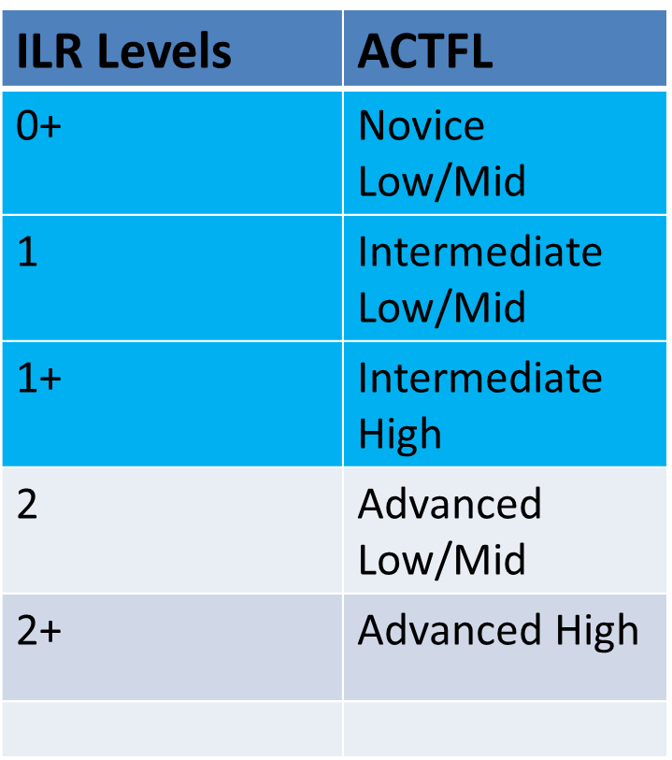
Comparing ACTFL and ILR Proficiency Scales

Slide 55
Challenges of OACD in Russian at Novice-Advanced Levels
At Novice and Intermediate levels, students have not yet attained the mastery of structural forms to deal with interchangeable thematically-organized blocks of instruction based on authentic materials.
200,000 inflectional paradigms producing 6,000,000 inflectional word forms.
(Kogan&Bondarenko, forthcoming in 2020)

Slide 56
Challenges of OACD in Russian at Novice-Advanced Levels
Solution:
Create a gradual transition from a linear, more traditional scope and sequence to an OADC by using the Gradual Release of Responsibility (GRR) Instructional Framework.
(Pearson and Gallagher, 1983)

Slide 57
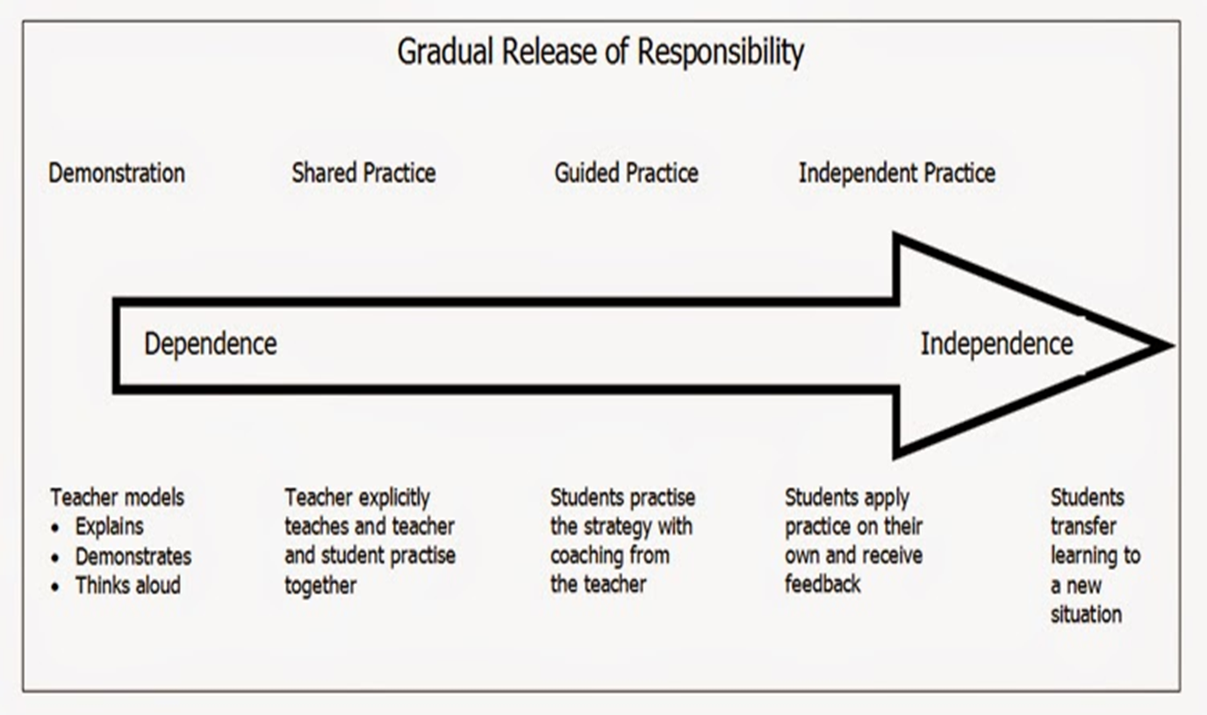
Transition to OACD:
GRR Instructional Framework
(Pearson and Gallagher, 1983)

Slide 58
Introducing Elements of OACD from Day One
Differentiate between receptive skills (listening and reading comprehension) and productive (speaking and writing).
Gradual acculturation to the structure of the Russian language is easier when the exposure to authentic materials starts with reading.

Slide 59
Examples of OACD: Level 0+
Day One of the Russian Course
Introduce the Russian alphabet in less than one hour using cognates (Leaver’s Model, 1984).
The author conducted this lesson during the pre-readiness courses (SLS101).
A booklet of 200 cognates was developed in 2014. It is covered in two hrs.
Based on strategy instruction of cognate recognition using comparative linguistic analysis (e.g. RU and Engl. suffixes).

Slide 60
Examples from the Book of Cognates
Contrastive Analysis of Suffixes
Час 2. Вокабулярий (чтение и слушание)
Прочитайте и поймите (Read and understand)
Серия 1A (Series 1A)
Структурные параллели: -ор, -ер, -ёр =
(-or, -er)

Slide 61
Examples from the Booklet of Cognates (P.M. - Krasner, 2014)
Профессии и люди [Professions and people]:
1. профессор
2. инспектор
4. aвиатор
диспетчер
дизайнер
доктор
диктатор ….

Slide 62
Elements of OACD at Level 0+:
Students Select Authentic
Materials from Day One (cont.)
Students select four-five cognates on a particular topic from the given list, and using them as key words, google articles on those topics.
Students are normally able to discern titles and main ideas of those articles.
Great motivational tool.

Slide 63
Example 1: Student Select Authentic
Materials from Day One
Cognates: Кризис (crisis), экономика (economics), программа (program), процесс (process), инфляция (inflation)
Current Internet subtitles:
“Тест по экономике на тему "Инфляция" 11 класс”.
“Кризис-2020: настанет ли он в Украине”.
“Инфляция: ее основные виды и методы регулирования”.

Slide 64

Example 2: Student Select Authentic
Materials from Day One
Cognates:
Балет (ballet), опера (opera), актер (actor), театр (theater), Москва (Moscow).
Current Internet subtitles:
Большой театр – официальный сайт
Teaтр Русский Балет
Афиша оперы в театрах Москвы на 2020, купить билеты на ...

Slide 65
OACD Elements at
Levels 0+, 1, 1+
Mirror authentic materials in the textbook and expand on them by adding task-based activities when students select their own authentic materials within a realistic scenario.
For instance, in the DLIFLC RU Basic course, there are authentic advertisements of apartments, cars, Help Wanted sections, etc. at levels 0+, 1 and 1+. Those texts could be expanded to OACD.

Slide 66



Expanding Level 0+ Textbook Materials to OACD
From the DLIFLC Russian Basic course.
Lesson 4. Week 2 of instruction.
VIII. Read the business cards below and complete the following table in Russian .
For help у́лица -street
Ковалёва Ве́ра Па́вловна
Координа́тор медици́нского прое́кта
Психо́лог
Респу́блика Ингуше́тия,
г. Назра́нь Тарги́м,
у́лица На́бережная 15, кварти́ра 31
Тел./Факс +7 (8732) 22-38-14
Си́доров Андре́й Алексе́евич
Фина́нсовый консульта́нт
г. Ирку́тск
у́лица Пу́шкина, дом 37, кварти́ра 15

Slide 67
Expanding Level 0+ Textbook Materials to OACD
Example 3: Task-Based Activity
Step 1 :
Find two-three Russian business cards on the Internet. Present them to your classmates in Russian, indicate first and last names, professions, and addresses of those individuals.
Step 2: Design your own business card, present it to the class.

Slide 68




Expanding Level 0+ Course Materials to OACD (cont.)
Some business cards found on the Internet:

Slide 69
Expanding Level 1+ Textbook Materials to OACD
From Lesson 8 of the DLIFLC Russian Basic course.
Topic “Clothes”. Week 5 of instruction.
Из росси́йской пре́ссы [from the Russian press]
Read the text and answer the questions below.

Slide 70
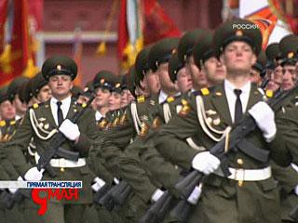
Expanding Level 1+ Textbook Materials to OACD
Photo: www.vesti.ru, 09.05.08
Но́вая пара́дная фо́рма Вооружѐнных сил (Armed Forces) продемонстри́рована в Москве.
Но́вая пара́дная фо́рма оде́жды Вооружённых сил продемонстри́рована на Кра́сной пло́щади. Её уви́дели во вре́мя пара́да Побе́ды, 9 ма́я. Но́вое в фо́рме – цвет. Он сде́лан по ста́рым росси́йским тради́циям XVII ве́ка, когда́ царь Пётр I ввёл в росси́йскую а́рмию европе́йскую кра́сно-зелёную фо́рму…. (www.vesti.ru, 09.05.08)

Slide 71
Expanding Level 1+ Textbook Materials to OACD
Example 5: Task-Based Activity:
Step 1
Work with the classmates of the same branch of service. Research on the Internet various Russian military uniforms of your particular service (service dress, camouflage, and regular uniforms). Describe them to your classmates.
Step 2
Compare Russian and American uniforms for your branch of service.

Slide 72


Inserting Elements of OACD to Existing Curriculum: Skills Integrated TBI Model
L
R
W
S
task L – Listening R – Reading W – Writing S - Speaking
Krasner, I. Model of Skills Integration in Teaching Foreign Languages. Master’s Degree Portfolio, 2000, Middlebury Institute of International Studies

Slide 73
Optimizing Learning through the Skill - Integrated Model
The proposed model uses various learning pathways in the brain (i.e., visual, auditory, kinesthetic/tactile) simultaneously or sequentially in order to enhance memory and learning.
Utilizing various sensory channels allows maximizing language acquisition and retention.
Creating visual, auditory and kinesthetic/tactile linguistic patterns through various sensory inputs and outputs is essential for deep processing and memory potentiation.
13

Slide 74
Using the Model at Levels 0+/1 for Guided OACD
Example 6:
Watch the video about the most popular names in Russia in 2019.
https://riafan.ru/1219290-populyarnye-imena-dlya-novorozhdennykh-v-2019-godu-infografika-fan-tv
Write down the most popular names for girls and boys that you hear.
Find on the Internet the most popular names in Russia the year or decade you were born.
Report back to class.

Slide 75

Using the Model at
Levels 0+/1 Authentic Materials
1980 — 1990
Впрочем, с конца 70-х в 80-е перешли многие иностранные варианты, такие как Эдуард, Алекс. Были даже Альфреды. Среди девичьих пользовались популярностью имена Ева, Жанетта, Магда, Рената. В больших количествах появились Снежаны, Златы, Маргариты, Валерии, Владилены. А вот мальчиков, наоборот, стали называть попроще: Андреями, Антонами, Володями, Ванями, Игорями, Мишами, Пашами. (http://www.asfera.info/news/society/2015/09/01/kakie_imena_bili_populyarnimi_raznoe_vremya_102008.html, retrieved on 01/03/2020)

Slide 76
Using the Model at Level 1 for more Autonomous Student Work
Example 7: Select a city in Russia.
Find online a weather report for this city for the next five days.
You can choose to work with reading, listening or video passage.
On the basis of what you have read/listened/watched, prepare a weather report for a local radio station or a newspaper.
Present your findings to the entire class.

Slide 77
Skill-Integrated Model as an Alternative Assessment Tool
“Elicitation and evaluation of language use (across all modalities) for expressing and interpreting meaning, within a well-defined communicative context (and audience), for a clear purpose, towards a valued goal or outcome.”
Norris, J. M. (2014, April). How do we assess task-based performance?
Invited LARC/CALPER testing and assessment webinar.

Slide 78
Criteria for Assessing
Oral (Group) Presentations:
Linguistic accuracy
Vocabulary
Text Type
Fluency/delivery
Presentation style
Content
Collaboration with others
Criteria can be relatively simple or quite elaborate.

Slide 79
Assessing Oral TBI Products
(adapted from http://www.docstoc.com/?ref_url=root1) adapted from http://www.docstoc.com/?ref_url=root1
 | Content/ Ideas | Word Choice/ Vocabulary | Grammatical/ Accuracy | Visuals | Organization | Spoken Fluency | Voice | Pronunciation
5 | Rich and Interesting; Provides in-depth understanding of the topic | Varied, engaging vocabulary and vocabulary from the unit is used throughout; no English used during the presentation | No predictable or avoidable errors (appropriate to the level); accurate information presented | Used attractive visuals that strongly supported the presentation; All could see and use the visuals from any point in the classroom; There are no words on the visuals other than titles (in Spanish). | Excellent organization; Logical and clear introduction, transitions and conclusion | Speaks clearly with appropriate pauses and inflection; very well-rehearsed; little to no reliance on note cards; excellent eye contact with the audience | Strong personality; highly original; evokes emotional response from the audience with tone of voice and expression; engages the audience; easy for all to hear | Applies pronunciation rules consistently
4 | Very good; some detail of the topic | Appropriate but predictable; no English used during the presentation | Few errors | Used attractive visuals but they could not be seen well throughout the classroom or they were less directly related to the topic | Very good | Speaks with minor hesitation; comprehensible to native speaker; may have read from notes from time to time but maintained good eye contact w/ audience | Personality and originality apparent; audience is interested in the presentation; no problems hearing the presentation | Applies pronunciation rules often
3 | Adequate, good; “tourist” level of understanding | Basic vocabulary – little variety for level; some misuse of words; a single word or phrase of English used once | Occasional errors, but comprehensible | Visuals did not show great pride in workmanship or they were not directly related to the presentation | Adequate, good | Speaks with little hesitation; comprehensible to teacher; frequently read from notes with little eye contact | Personality and originality emerging; audience is less engaged in the presentation; difficulty hearing from time to time | Applies most pronunciation rules
2 | Weak; missing requirements; vague | Weak; repetitive; misuse of dictionary; poor word choices; English used more than once | Seldom clear; interference from patterns of errors | Very sloppy visuals or visuals were not relevant to the topic | Weak | Speaks with some hesitation; difficult to understand and/or mainly read from paper | Little evidence of originality; indifferent; did not engage audience; difficult to hear | Applies some basic pronunciation rules
1 | Misleading; No effort to meet requirements | Inappropriate; may slip into English from time to time | Poor, not comprehensible - So many errors, it’s difficult to comprehend | No visuals | Misleading, Missing key elements | Speaks with great hesitation; barely comprehensible and/or read directly from paper; monotone | Little/ no originality; Lack of enthusiasm; Disengaged and disinterested audience | Does not apply basic pronunciation rules
0 | Little/none | Little/none | Missing, very little |  | None | None | None | Grunts

Slide 80
Assessing Written TBI Products
(adapted from http://www.docstoc.com/?ref_url=root1) adapted from http://www.docstoc.com/?ref_url=root1
 | Content/ Ideas | Word Choice/ Vocabulary | Structural/ Accuracy | Visuals | Organization
5 | Rich and Interesting; Provides in-depth understanding of the topic | Varied, engaging vocabulary and vocabulary from the unit is used throughout; no English used during the presentation | No predictable or avoidable errors (appropriate to the level); accurate information presented | Used attractive visuals that strongly supported the presentation; All could see and use the visuals from any point in the classroom; There are no words on the visuals other than titles (in Spanish). | Excellent organization; Logical and clear introduction, transitions and conclusion
4 | Very good; some detail of the topic | Appropriate but predictable; no English used during the presentation | Few errors | Used attractive visuals but they could not be seen well throughout the classroom or they were less directly related to the topic | Very good
3 | Adequate, good; “tourist” level of understanding | Basic vocabulary – little variety for level; some misuse of words; a single word or phrase of English used once | Occasional errors, but comprehensible | Visuals did not show great pride in workmanship or they were not directly related to the presentation | Adequate, good
2 | Weak; missing requirements; vague | Weak; repetitive; misuse of dictionary; poor word choices; English used more than once | Seldom clear; interference from patterns of errors | Very sloppy visuals or visuals were not relevant to the topic | Weak
1 | Misleading; No effort to meet requirements | Inappropriate; may slip into English from time to time | Poor, not comprehensible - So many errors, it’s difficult to comprehend | No visuals | Misleading, Missing key elements
0 | Little/none | Little/none | Missing, very little | No Visuals | None

Slide 81


Questions

Slide 82
Bibliography
Ellis, R. 2003. Task-based language learning and teaching. Oxford: Oxford University Press
Bondarenko, M., & Kogan, V. (submitted manuscript). Open Architecture Design Meeting Cognitive Architecture: Spiral-like Design Model or Teaching Inflectional Languages at Elementary Levels, In A. Corin, Campbell, C., & Leaver, B. (eds.) Open Architecture Curricular Design. Open Architecture Curricular Design: Courses and Concepts. Georgetown University Press.
Krasner, I. 2000. Model of Skills Integration in Teaching Foreign Languages,
Position Paper, Master’s Degree Portfolio, Monterey Institute of International Studies, Monterey, CA, USA
Krasner, I. 2007. Communicative Model of Teaching Russian as a Second Language// Newsletter of the American Council of Teachers of Russian, 34 (1), 1-2&9.
Krasner, I. 2007: Коммуникативные задания в обучении русскому языку, International Congress of Teachers of the Russian Language and Literature, Proceedings. Volume 9.
Leaver, B. 2019. Foreign Language Pedagogy Podcast, FEB 28, 2019. 20-minute introduction into Russian alphabet.
Macmillan.

Slide 83
Optional Slides

Slide 84
Bridges as a Transitional Tool from a Linear Curriculum to the OACD
Bridge is a sequence of skill-integrated proficiency- oriented task-based activities that allow students to try their acquired knowledge in real-life situations.
Bridges are based on the same Skill-integrated Model but used simultaneously multiple times.

Slide 85
Examples of Bridges
Bridges in the DLIFLC Russian Basic course were developed for Mid Module 2 (Level1); Module 3 (Level1+); Module 5 (Levels 2/2+)
Mid Module 2 (Level 1) Bridge corresponds to weeks 10-11of instruction.

Slide 86
Level 1 Bridge (Mid Module 2)
Week 10 of Instruction
The plot of Mid Module 2 Bridge is about six characters.
They are immigrants from living in the US.
They all have some problems adjusting to the American life.
The Bridge contains two dialogues (A&B) and two [e-mail] letters (A&B) per character

Slide 87
Level 1Bridge Mid Module 2
Task Sequence:
Students work in pairs.
Step 1 (Introduction/Schemata Building):
Students listen to a short radio show containing interviews with all six characters.
Step 2 (Negotiation of Meaning):
Based on what they heard, each pair selects one character they like. They have to negotiate the selection in Russian.

Slide 88
Bridge Mid Module 2
Step 3 (Info-Gap, HOT):
Each pair researches their character:
Student A receives dialogue A and text A about the character.
Student B receives dialogue B and text B about the same character.
Step 4 (Student Choice): Each student has a choice of starting with listening or reading. Each dialogue and text complement each other.

Slide 89
Bridge Mid Module 2
Step 5 (Info-Gap, HOT):
Students exchange information about their character. They have guided questions which they ask each other in Russian to have the whole picture/storyline about their character.
Step 6 (Synthesizing & Problem Solving, HOT)
Students report their findings to the class and suggest solutions for their character’s problems.

Slide 90

Bridge Mid Module 2
Characters’ Intro
Гриша
Он бизнесмен. Раньше он жил в России, а теперь живёт в Америке. Гриша хочет встретить хорошую девушку.
Слушайте, читайте и узнаете, что нового в его жизни.

Slide 91

Bridge Mid Module 2
Characters’ Intro (cont.)
Оксана
Её муж – американец. Как вы думаете, Оксана любит Америку и её мужа или она хочет вернуться домой в Украину? Читайте, слушайте и узнаете ответы на эти вопросы.

Slide 92
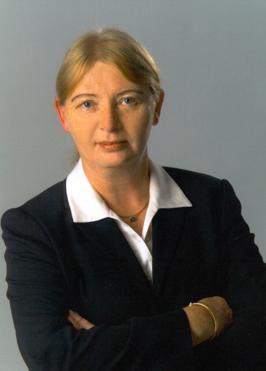
Bridge Mid Module 2
Characters’ Intro (cont.)
Галина Степановна
Раньше она жила в Нью-Йорке и работала секретаршей. А сейчас она живёт в Монтерее, и у неё новая работа. Какая? Слушайте, читайте и узнаете.

